Slide 1

Being a Virginia Master Naturalist Volunteer: An Introduction

Slide 2

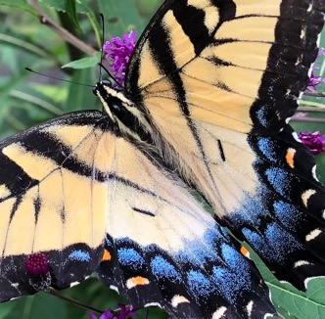
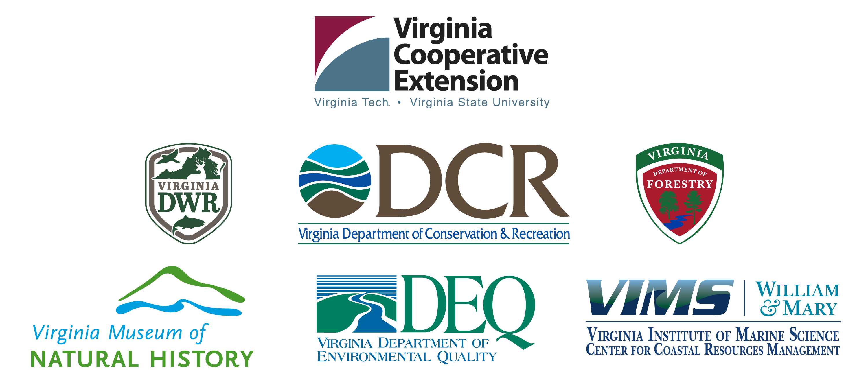
Sponsors
Virginia Cooperative Extension is a partnership of Virginia Tech, Virginia State University, the U.S. Department of Agriculture, and local governments. Its programs and employment are
open to all, regardless of age, color, disability, gender, gender identity, gender expression,
national origin, political affiliation, race, religion, sexual orientation, genetic information, military status, or any other basis protected by law.
Notes:
On behalf of Virginia Cooperative Extension and all our state agency sponsors, I welcome each of you as a Virginia Master Naturalist program volunteer trainee!

Slide 3
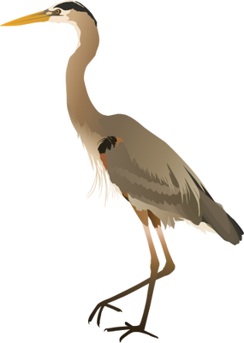
Agenda
1
What You’ll Gain from VMN Participation
2
Program Overview
3
Program Structure: Sponsors, Chapters, And You
4
Training, Continuing Education, and Service
5
Earning the Certified VMN Title/Qualification
6
Other Things to Know: Recognition, Documentation, Conduct
Integration and Application Network (ian.umces.edu/media-library) CC BY-SA 4.0
Notes:
Our task today is to make sure you know what the Virginia Master Naturalist program is all about, your role as a volunteer, guidelines for training and service, and what is expected of you.

Slide 4
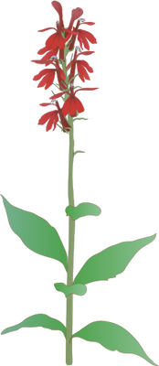
What will you gain as a Virginia Master Naturalist volunteer?
Integration and Application Network (ian.umces.edu/media-library) CC BY-SA 4.0
Notes:
Thank you for making the decision to be a Virginia Master Naturalist volunteer! I think you’ll be glad you did. Here are some of the benefits you’ll gain from being an active member of the program.

Slide 5
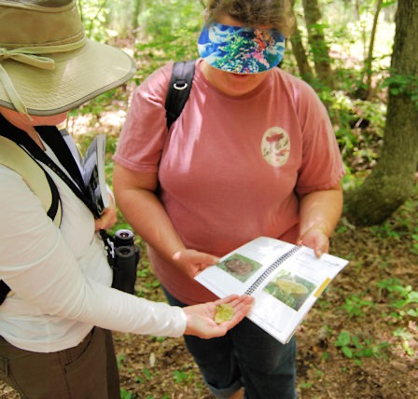
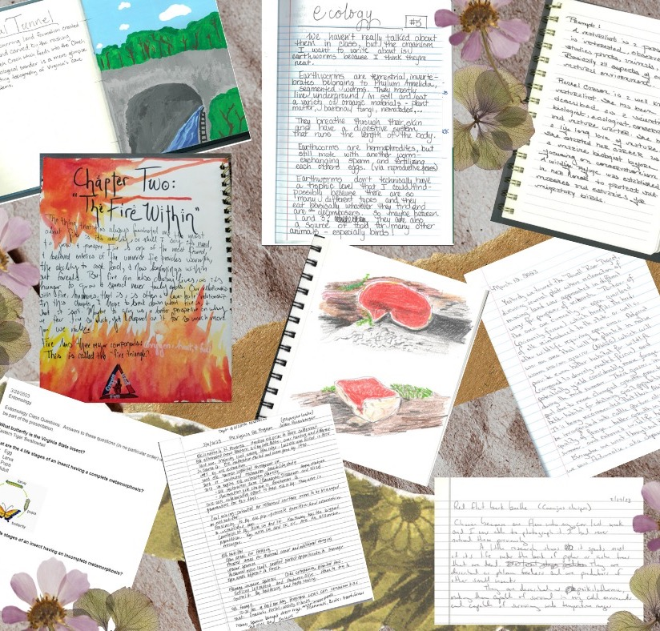
Learning
VMN-Blue Ridge Foothills and Lakes Chapter
VMN-High Knob Chapter
Notes:
One of the top reasons people join the program is to learn. Whether you are joining as someone completely new to natural resources or as a natural resource professional, you will have a lot of opportunity to learn about nature, especially the nature of your local area. Lifelong learning is core to what we do, and you’ll be learning through this basic training, through future continuing education that you do, and through your volunteer service. We hope that the program inspires you to learn on your own as well!

Slide 6
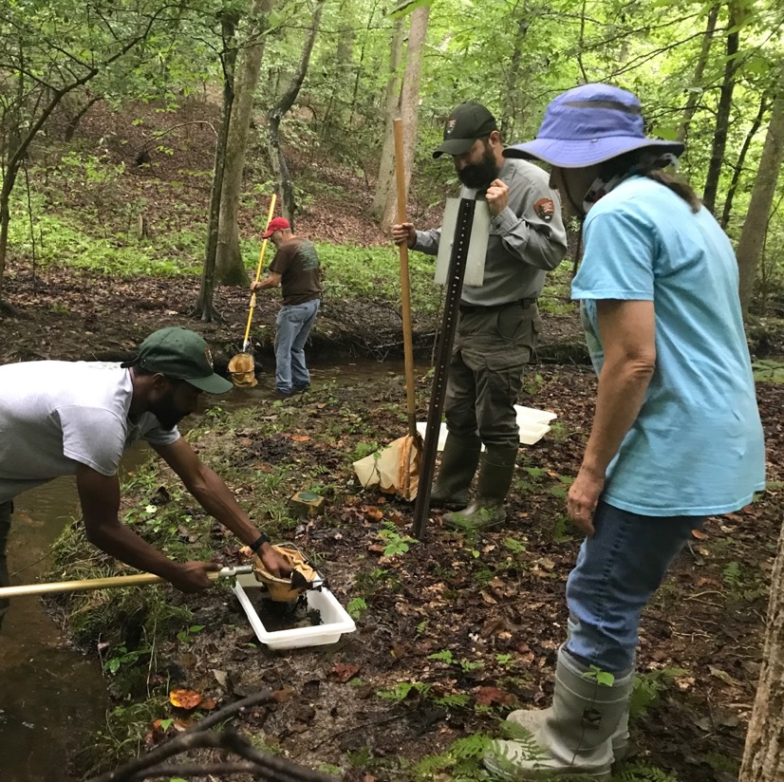
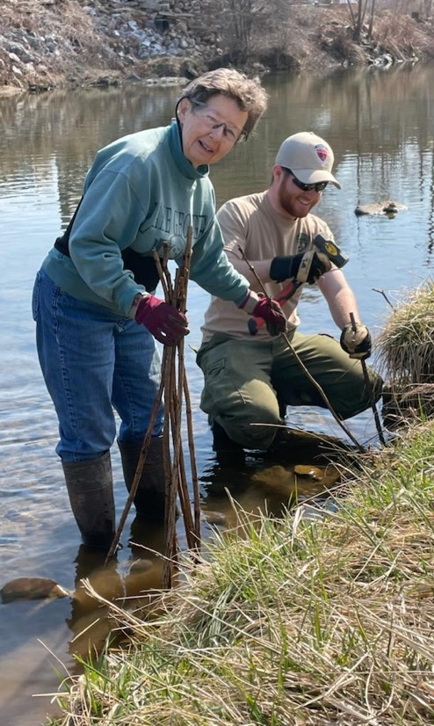
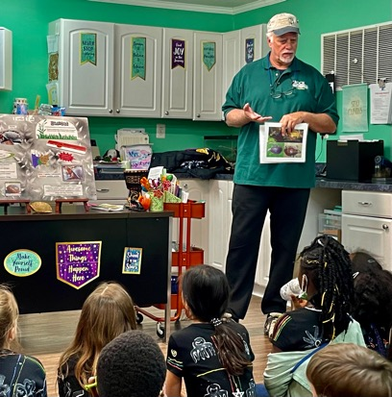
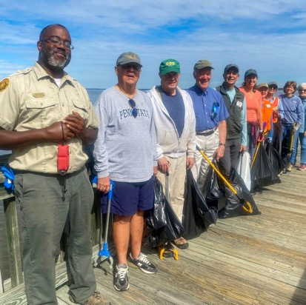
Opportunity to Contribute
Jerry Nissley
Alison Sinclair
Karen Milne
Judy Jones
Notes:
Speaking of volunteer service, that’s really why the program exists—not just for learning, but for applying what you learn to help with natural resource education and conservation in your community. As a Virginia Master Naturalist volunteer, you will have countless opportunities to give back.

Slide 7
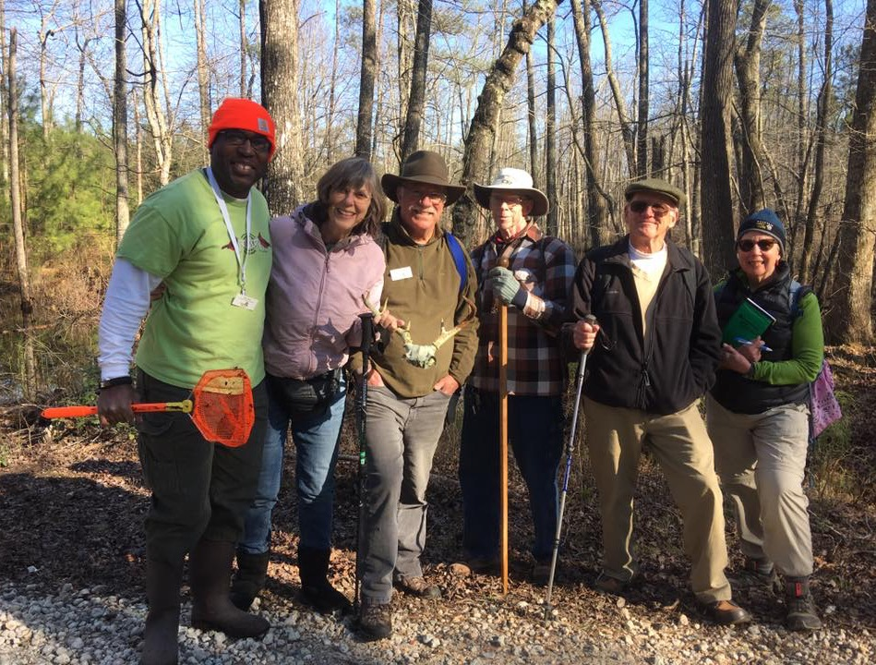
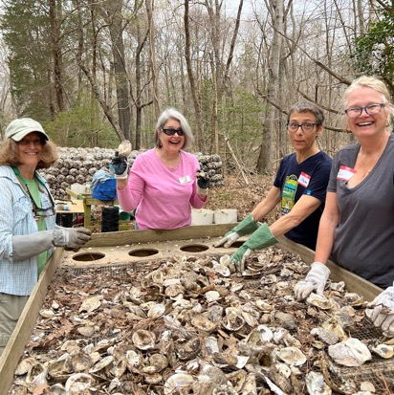
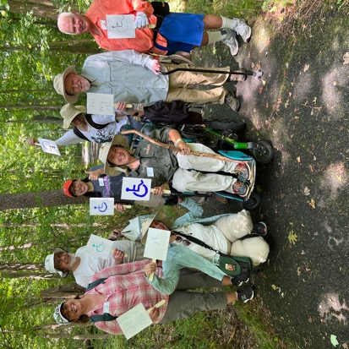
Social Connections
Cindy Andrews
VMN-Pocahontas Chapter
Lisa Matthews
Notes:
The program is set up with chapters, because we know that being part of a team is important to so many volunteers. Many people come to the program looking to meet other people who are also interested in learning about nature and volunteering. We are sure you will make some new friends in this program!

Slide 8
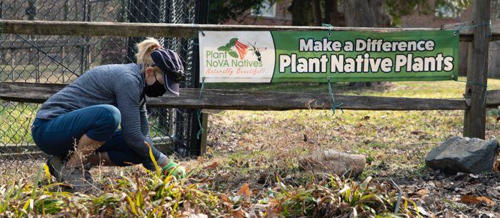
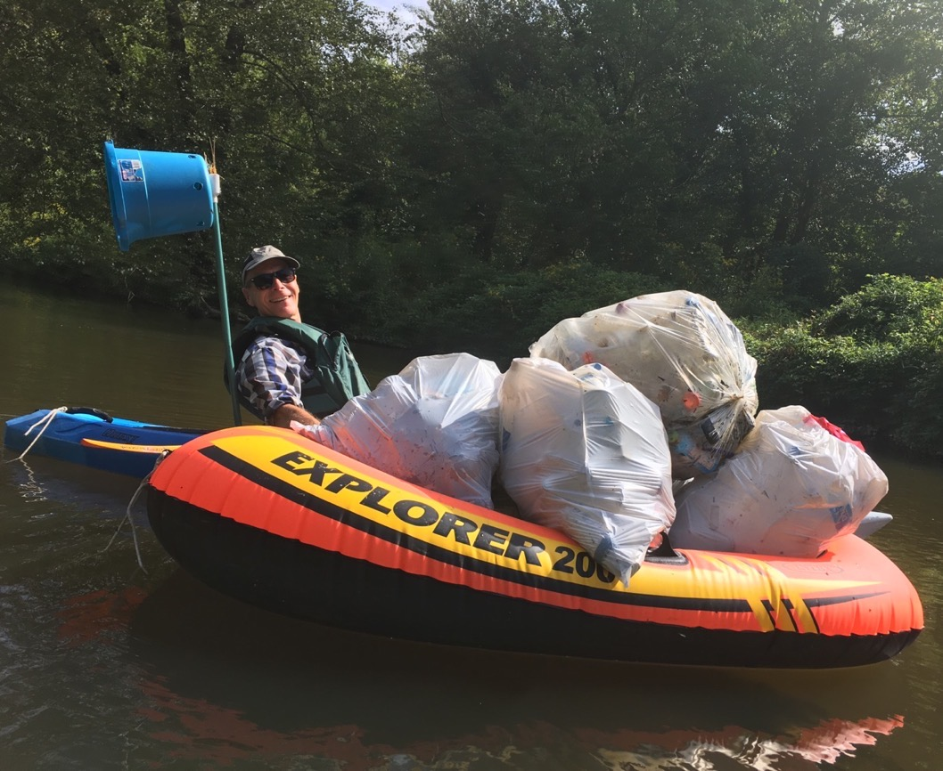
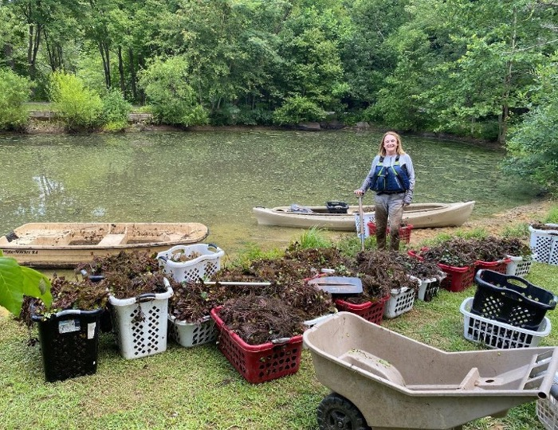
Sense of Accomplishment
Toni Genberg
VMN-Fairfax Chapter
Ron Grimes
Notes:
Through your learning and your volunteer service, you will feel a sense of accomplishment. Maybe you’ll be the person to help clean up the river, or to spark a child’s interest in nature, or to contribute something important to a scientific study.

Slide 9
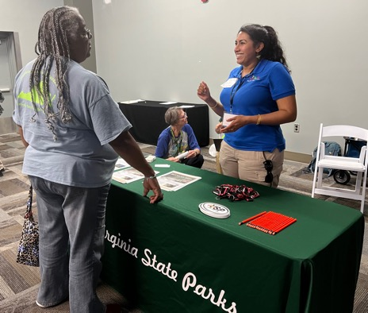
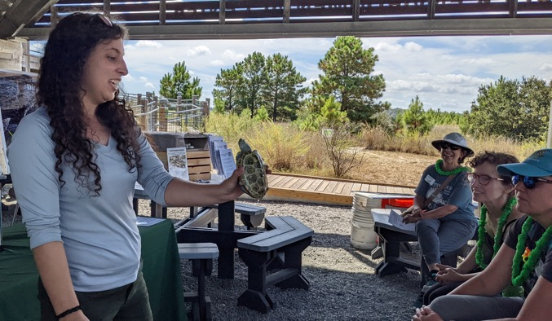
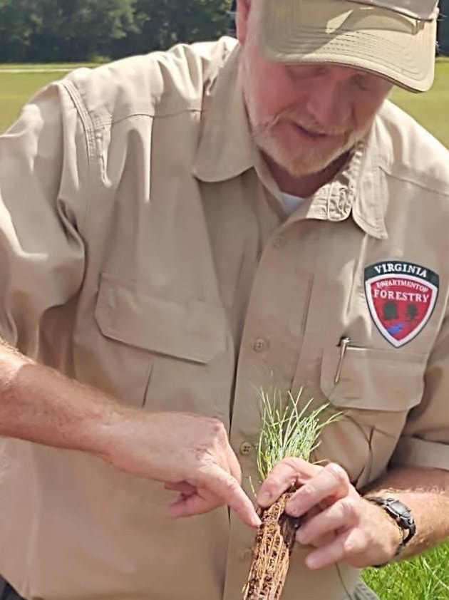
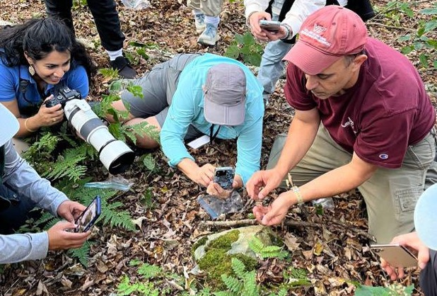
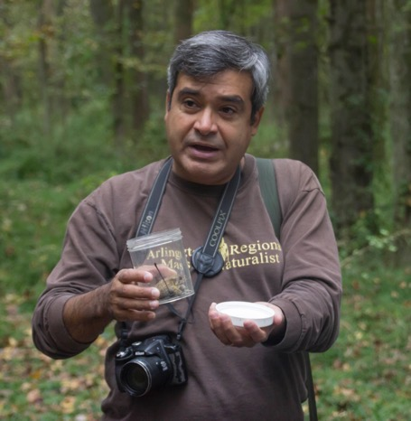
Connections to People
Michelle Prysby
Jody Ullmann
Brenda Poist
Terri Mewborn
Geneviève de Messières
Notes:
Most of all, the Virginia Master Naturalist program is about building connections. Through the program, you will gain connections to people – not just your fellow Virginia Master Naturalist volunteers, but also natural resource experts, state agency personnel who manage state lands or educate people about natural resources, and people who work with all kinds of nature-related organizations.

Slide 10
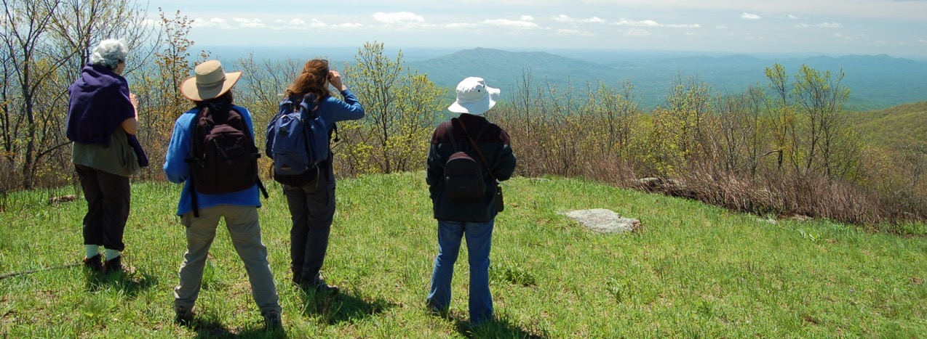
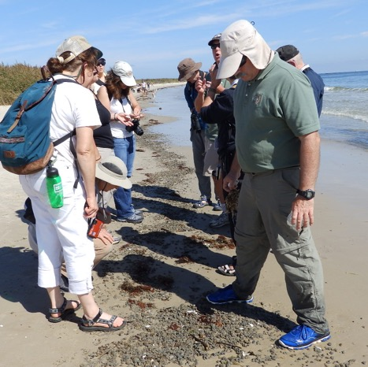
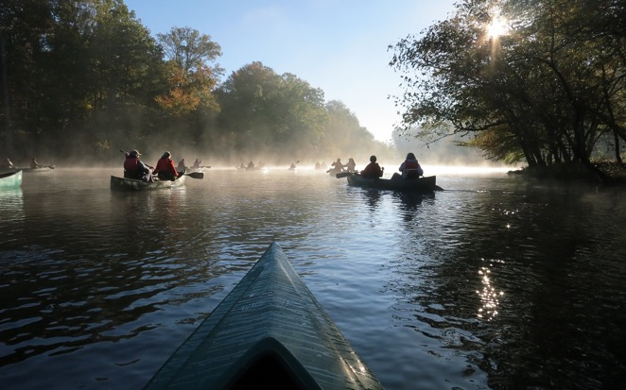
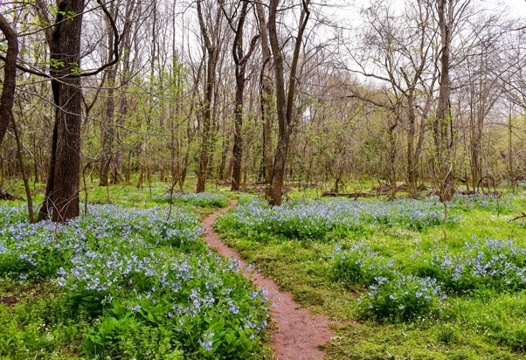
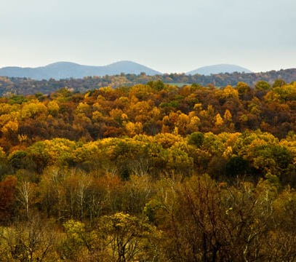
Connections to Places
John Stanley
Donna Finnegan
Rich Brager
Maria Cannata
Carol Hammer
Notes:
You’ll also get connected to places where you can observe and enjoy nature. Those places could in the wilderness or in urban areas – we can find green spaces even in our biggest cities. You’ll have field trips to these locations, or you may have service activities there.

Slide 11
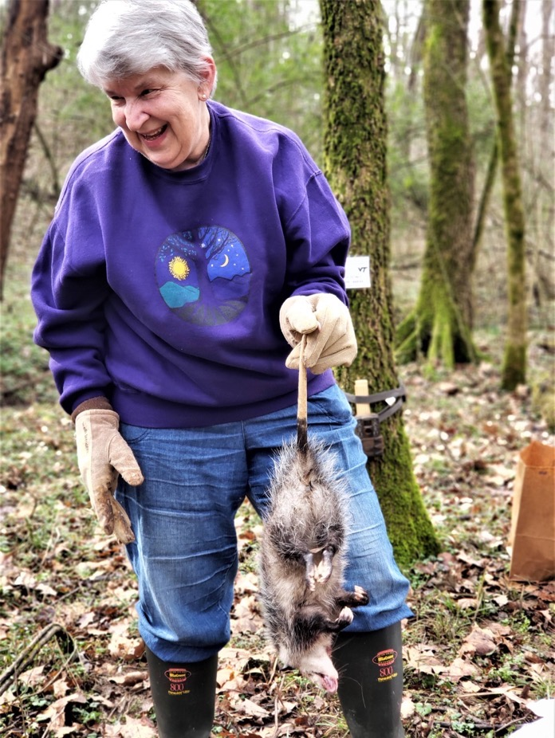
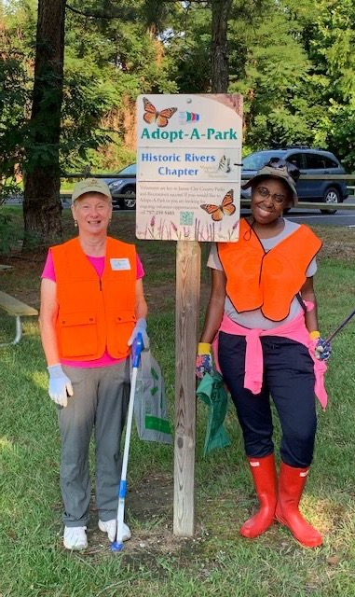
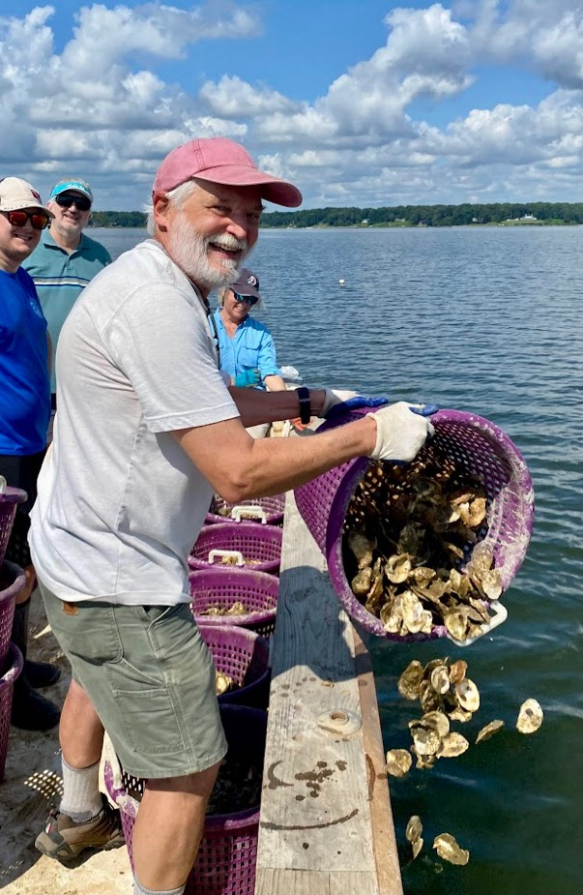
Connections to Projects
Janet Hormes
Connie Reitz
Cindy Andrews
Notes:
And, we will connect you to projects – service activities where you can make a real contribution. Some of them might be things you never dreamed you would be doing—like this volunteer baiting a camera trap as part of a study of spotted skunks in Virginia. We’ll talk more about service activities later.

Slide 12
Credentials
Notes:
If you complete the requirements, you will earn the Certified Virginia Master Naturalist title. While this is not a professional certification, it is still a credential that you are welcome to use on your resume or just to document your level of achievement. We’ll talk more about certification requirements in a bit.

Slide 13
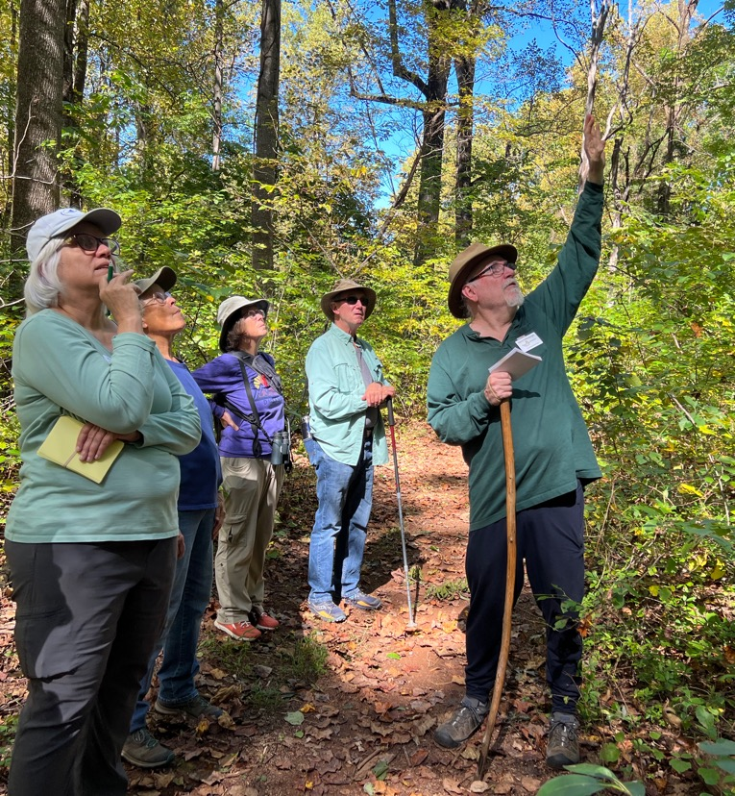
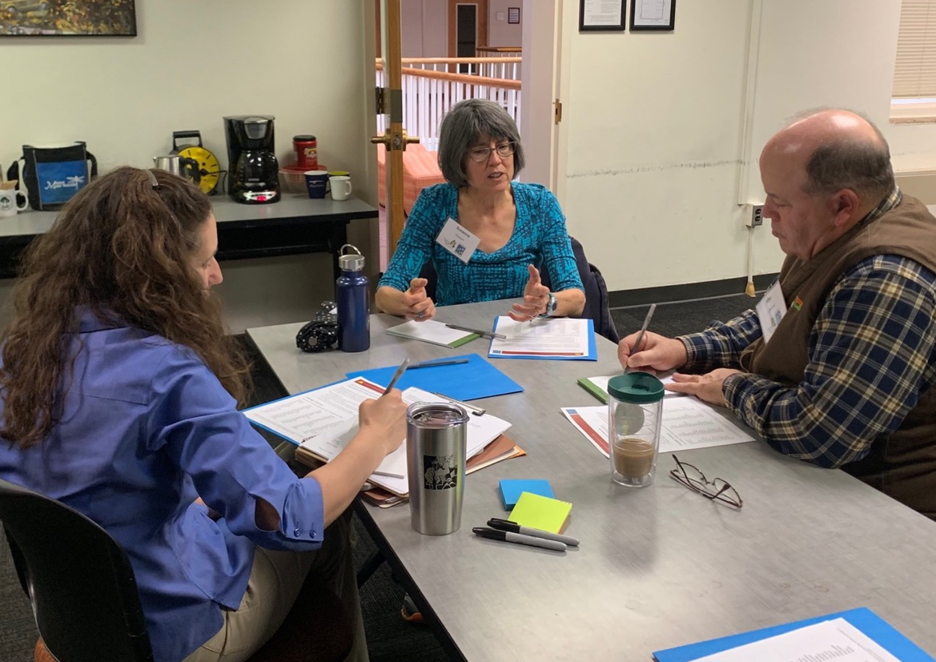
Leadership Experience
Michelle Prysby
Jennifer Gagnon
Notes:
We also hope that you will gain leadership experience. With the training you’ll complete and the experiences you will have, you will be someone who can lead others in learning and service.

Slide 14

What is the Virginia Master Naturalist Program, anyway?
Integration and Application Network (ian.umces.edu/media-library) CC BY-SA 4.0
Notes:
Let’s dive into what the Virginia Master Naturalist program is all about.

Slide 15
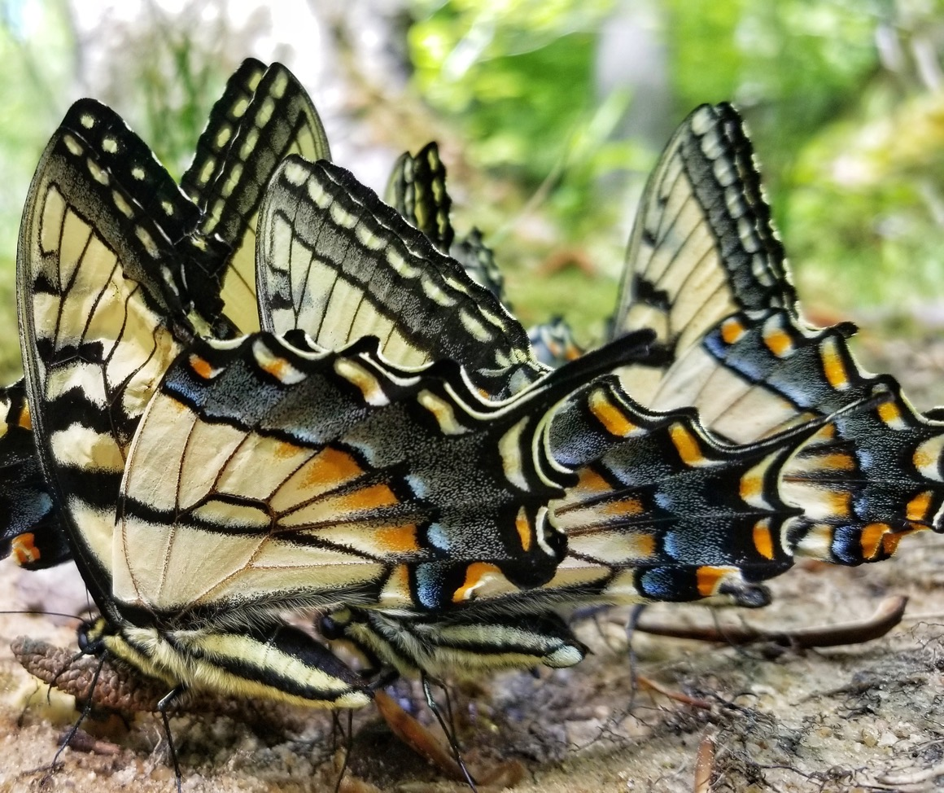
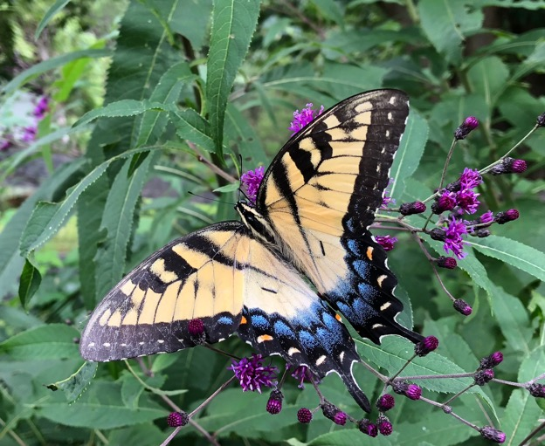
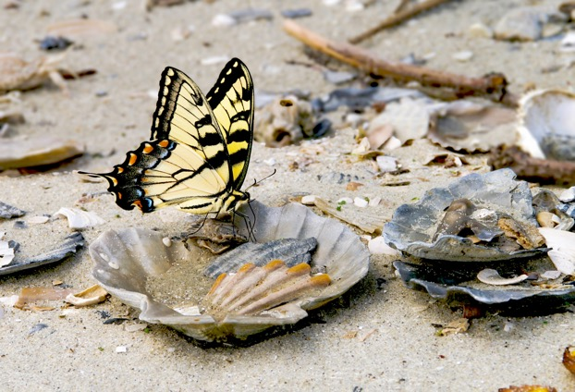
Placeholder page for partner discussion
Kevin Divins
Michelle Prysby
Felice Bond
Notes:
Pretend as if you were getting ready to come to class tonight when a neighbor calls you on the phone. You said, “I can’t talk right now, I’m on my way to participate in the Virginia Master Naturalist program.” Your neighbor asks, “The Virginia Master Naturalist program? What’s that?” Talk to the person sitting next to you about how you would answer that question.
[Presenter – After ~2 minutes, have participants share popcorn-style the words or phrases that came up (not everything they said) in their discussion. Especially highlight words/phrases related to volunteerism, and make sure to mention that one if no participant does.]

Slide 16
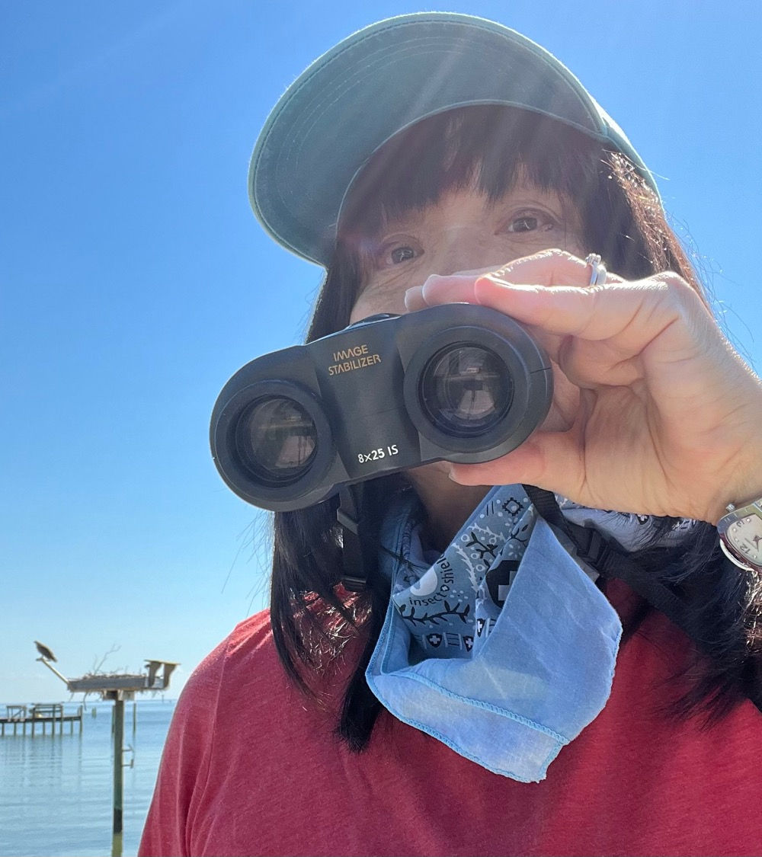
Our Mission
The Virginia Master Naturalist program is a statewide corps of volunteers providing education, outreach, and service dedicated to the beneficial management of natural resources and natural areas within their communities.
Tomoko Hamada
Notes:
In short, you could describe the VMN program as a statewide volunteer program focused on natural resources. Our official mission is to be a statewide corps of volunteers providing education, outreach, and service dedicated to the beneficial management of natural resources and natural areas within their communities. The program was first launched in 2005, and it has grown tremendously since then.

Slide 17
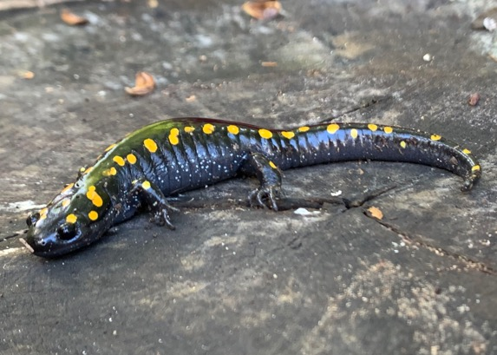
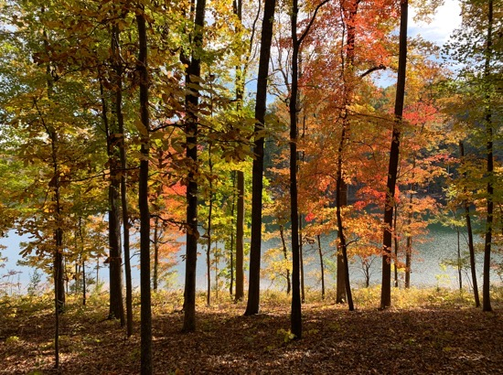
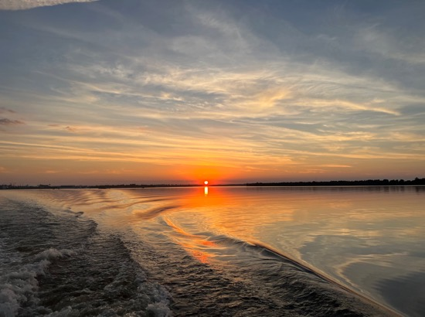
Focus on Natural Resources
A program to benefit Virginia’s wildlife, woods, waters, and other natural resources
Michelle Prysby
Michelle Prysby
Michelle Prysby
Notes:
You can think about the program as having three key elements. One is a focus on natural resources – Virginia’s woods, wildlife, and waters.

Slide 18
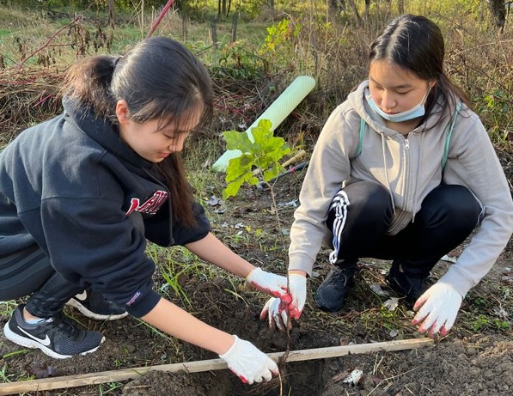
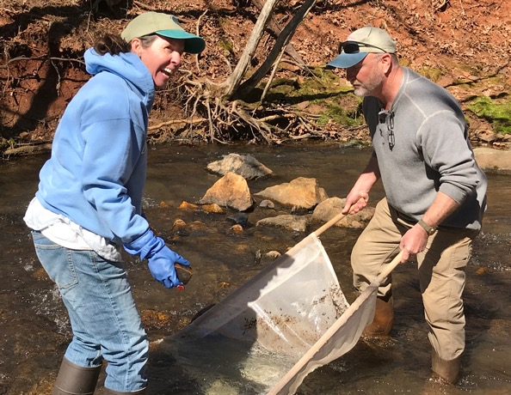
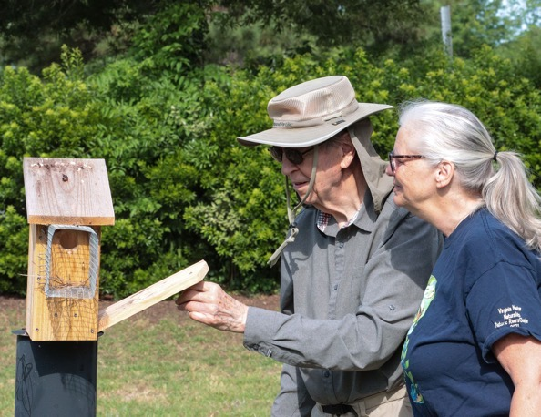
Focus on Volunteerism
A program to cultivate volunteers…
Susan Laume
Jennifer Helms
Deborah Humphries
Notes:
An important element is a focus on volunteerism. While we hope that you will learn a lot by participating in the VMN program, the real purpose of the program is to engage you as a volunteer and involve you in service. VMN is a program that cultivates volunteers…

Slide 19
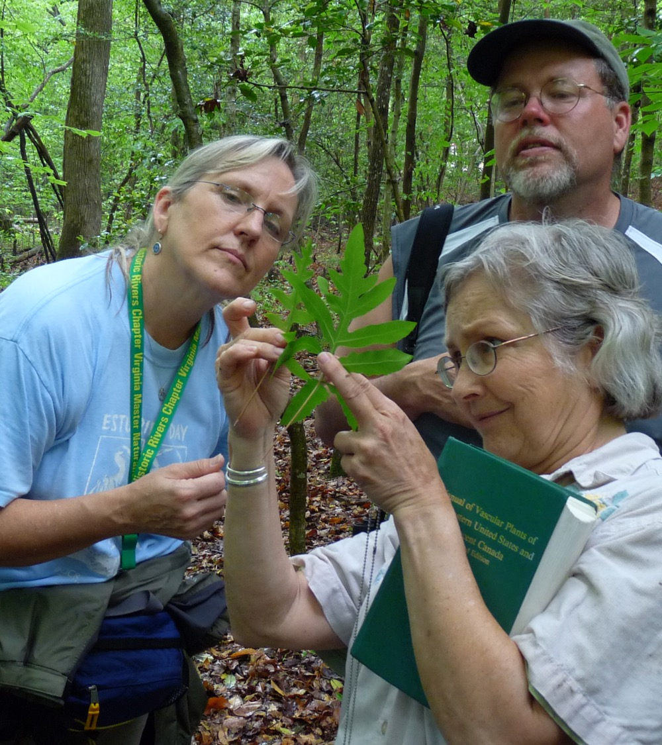
From Training…
Cultivating Volunteers
All VMN volunteers complete a basic training course with a local chapter.
VMN-Historic Rivers Chapter
Notes:
…providing training to get participants connected and to build their knowledge and skills,

Slide 20
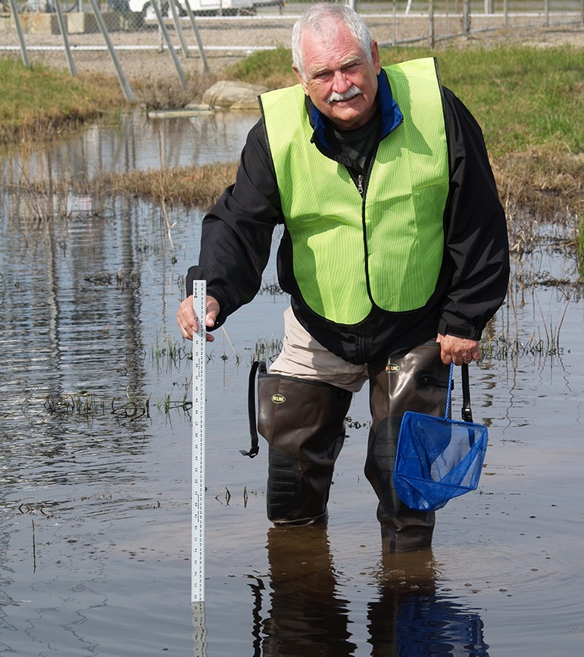
…to Service
Cultivating Volunteers
All VMN volunteers are expected to do at least some approved service.
Hart Haynes
Notes:
…then helping them find opportunities to use their knowledge and skills to benefit natural resource education and conservation.

Slide 21
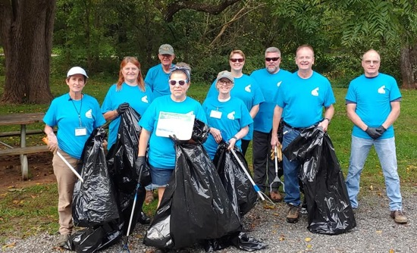
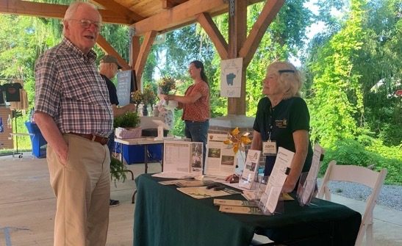
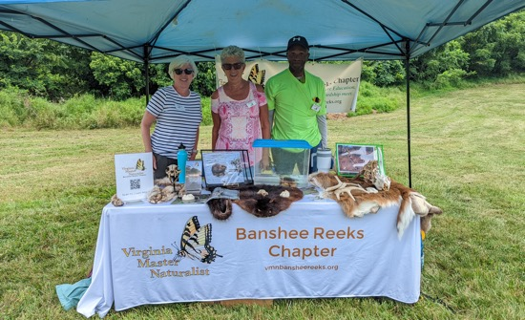
Focus on Community
Chapter-based
Partnerships
Collaboration
VMN-Roanoke Valley Chapter
Ellen Schrock
Susan Sims
Notes:
It also is a program focused on community and partnership. Our chapters are communities themselves—groups of people with a shared interest in natural resource conservation. They are working together to address the natural resource conservation needs of the broader community that they serve, which could be a city or county or multiple counties, or sometimes a watershed. Most projects that VMN volunteers do involve collaboration in some way. Our Virginia Master Naturalist chapters become a way for many local partners involved in natural resource education and conservation to work together to cultivate and engage a group of motivated and trained volunteers. And, at the state level, the program has many different sponsoring agencies that collaborate to support the program.

Slide 22
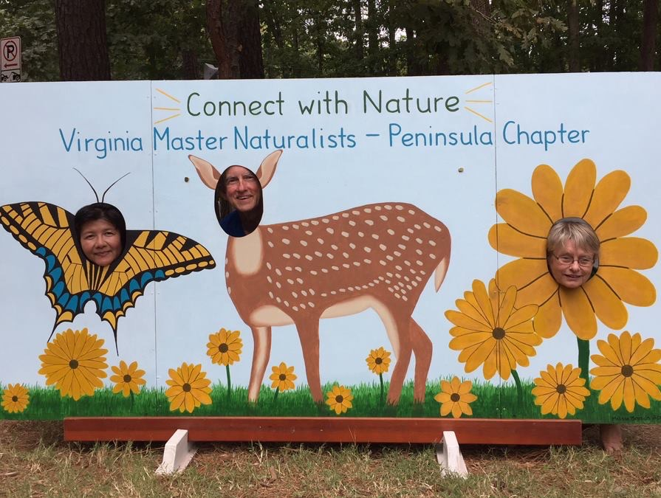
Your Assignment
Create your own VMN ‘elevator speech’ so that you can describe the program to someone in 1 or 2 minutes
VMN-Pocahontas Chapter
Notes:
Your assignment to complete on your own after this class is to develop your own VMN elevator speech so that you can describe the program to someone in a couple of minutes. If you are out volunteering, cleaning up a stream or counting birds or leading a walk, you want to be ready to tell people you encounter a bit about who you are, what you are doing, and why.

Slide 23
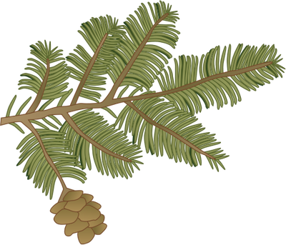
How is the Virginia Master Naturalist Program structured?
Integration and Application Network (ian.umces.edu/media-library) CC BY-SA 4.0
Notes:
Next, let’s talk about how the program is structured and where you fit in.

Slide 24
State-Sponsored Program
A statewide Virginia Cooperative Extension program
Sponsored by six additional state agencies
Notes:
The Virginia Master Naturalist program is a statewide program that is based in Virginia Cooperative Extension and sponsored by six other state agencies. You are all, at the moment, currently enrolled volunteers with Virginia Cooperative Extension.
There are Master Naturalist programs in many states, but Virginia’s program is unique because we have seven different state agencies that co-sponsor the program. They are Virginia Cooperative Extension, the Virginia Department of Conservation and Recreation, the Virginia Department of Environmental Quality, the Virginia Department of Forestry, the Virginia Department of Wildlife Resources, the Virginia Museum of Natural History, and the Virginia Institute of Marine Science’s Center for Coastal Resources Management. The program itself is not an independent non-profit organization—it is part of Extension and the university.

Slide 25
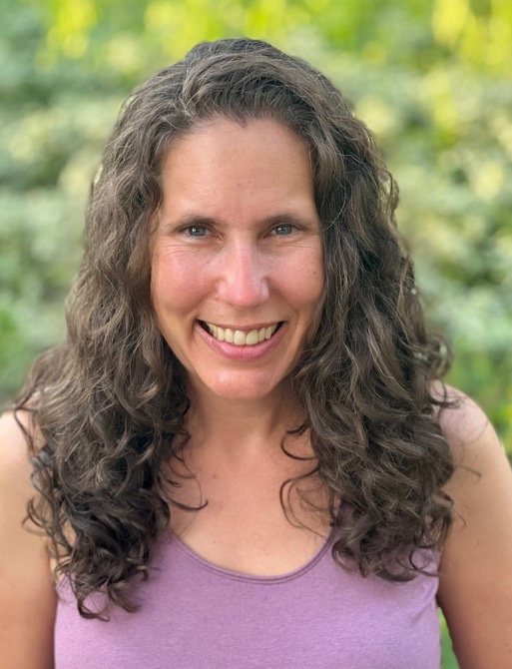
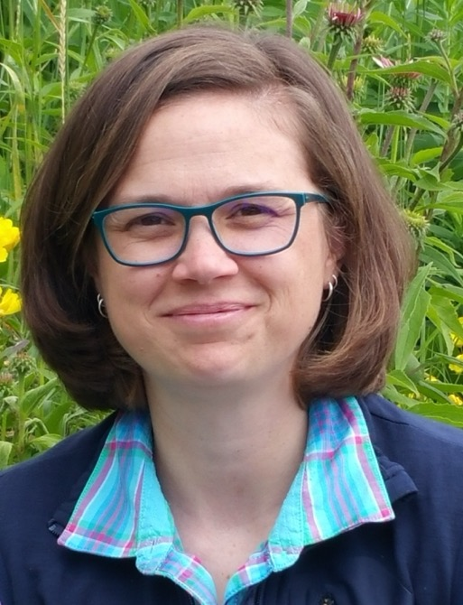
VMN State Office
Based at Virginia Tech’s Department of Forest Resources and Environmental Conservation
in the College of Natural Resources and Environment
Michelle Prysby
Virginia Master Naturalist Program Director
Faculty, Virginia Tech Department of Forest Resources and Environmental Conservation
Tiffany Brown
Virginia Master Naturalist Program Assistant
Staff, Virginia Tech Department of Forest Resources and Environmental Conservation
Notes:
The Virginia Tech Department of Forest Resources and Environmental Conservation within the Virginia Tech College of Natural Resources and Environment is the administrative home of the program staff. They are Michelle Prysby (Program Director and Extension faculty) and Tiffany Brown (Program Assistant). You will hear from Michelle and Tiffany regularly through our bi-weekly email announcements, quarterly e-newsletter, and other communications.

Slide 26

Virginia Cooperative Extension
VMN Sponsoring Agency
Mission: Virginia Cooperative Extension helps lead the engagement mission of Virginia Tech and Virginia State University, the commonwealth’s land-grant universities. Building local relationships and collaborative partnerships, we help people put scientific knowledge to work through learning experiences that improve economic, environmental, and social well-being.
Agriculture and Natural Resources
4-H youth development
Family and Consumer Sciences
Community Viability
http://www.ext.vt.edu
Notes:
Let’s talk briefly about each of the seven sponsoring agencies. You may have instructors from some of these agencies as part of your training course.
[Presenter note – If there is someone in the room from a sponsoring agency, such as the chapter advisor, have them say a few words about their agency when you get to that slide,]
Virginia Cooperative Extension is the outreach arm of Virginia’s land-grant universities, Virginia Tech and Virginia State University. It’s called “cooperative”, because Extension is a collaboration among federal, state, and local government. Extension operates out of 107 offices all across Virginia, in every locality, plus Agriculture Experiment Stations and 4-H centers. VCE provides research-based knowledge to people and communities to help them address challenges they face, whether those are related to farming, forestry, youth development, nutrition, health, community vitality, and a wide variety of other topics. Virginia Master Naturalists volunteer with Extension on activities such as 4-H nature programs for youth, creating native plant demonstration gardens, and monitoring for invasive pests. And, of course, our program as a whole is an Extension program, as we have mentioned.

Slide 27

Virginia Department of Conservation and Recreation
VMN Sponsoring Agency
Mission: DCR enables and encourages people to enjoy and benefit from Virginia’s natural and cultural resources
State Parks
Soil and Water Conservation
Natural Heritage Program
Dam safety and floodplain management
Land conservation
Recreation planning
http://www.dcr.virginia.gov
Notes:
Have you visited one of Virginia’s State Parks? If so, then you’ve interacted with the Virginia Department of Conservation and Recreation. Along with more than 40 State Parks, DCR also is home to the Virginia Natural Heritage Program, which collects and shares data on Virginia’s ecological communities and rare species. There are more than 65 Natural Area Preserves around Virginia. These lands are preserved for the protection of rare plants and animals and natural communities, so not all have public access. The agency has additional departments, such as recreation and trails planning. Virginia Master Naturalists do many service activities at Virginia’s State Parks and Natural Area Preserves, including interpretive walks and habitat restoration.

Slide 28

Virginia Department of Environmental Quality
VMN Sponsoring Agency
Mission: DEQ protects and enhances Virginia’s environment, and promotes the health and well being of the citizens of the Commonwealth
Administers state and federal laws and regulations for air quality, water quality, water supply and waste management.
DEQ issues permits, conducts inspections and monitoring, and enforces regulations and permits
Organizes citizen water quality monitoring
https://www.deq.virginia.gov
Notes:
The Virginia Department of Environmental Quality is the agency that administers state and federal laws and regulations relating to air quality, water quality, water supply, and waste management. Nearly all of our chapters are involved in monitoring the quality of Virginia’s streams, rivers, and lakes, sometimes directly with DEQ and sometimes with other watershed organizations.

Slide 29

Virginia Department of Forestry
VMN Sponsoring Agency
Mission: We protect and develop healthy, sustainable forest resources for Virginians.
Protects >16 million acres of forest land from fire, insects, and disease.
Manages 26 State Forests and other state lands totaling >70,000 acres for timber, recreation, water, research, wildlife, and biodiversity.
Provides technical advice to private forest landowners
http://www.dof.virginia.gov
Notes:
The Virginia Department of Forestry is the agency protecting Virginia’s more than 16 million acres of forests. They manage some public lands, which include 26 state forests. [Presenter note – Point out any State Forests that are in the chapter’s area.] But, the majority of Virginia’s forests are privately owned, so much of what the agency does is provide advice to private forest landowners to help them meet their forest management goals. Some activities that VMN volunteers do with DOF include collecting acorns for the agency to grow at their nurseries for reforestation projects and doing environmental education using the Project Learning Tree curriculum.

Slide 30

Virginia Department of Wildlife Resources
VMN Sponsoring Agency
Mission:
Conserve and manage wildlife populations and habitat for the benefit of present and future generations.
Connect people to Virginia’s outdoors through boating, education, fishing, hunting, trapping, wildlife viewing, and other wildlife-related activities.
Protect people and property by promoting safe outdoor experiences and managing human-wildlife conflicts. http://www.dwr.virginia.gov
Notes:
If you are a hunter or angler or boater, you may already be familiar with the Virginia Department of Wildlife Resources. This state agency’s mission is to conserve and manage Virginia’s wildlife population and wildlife habitat, to connect people to Virginia’s outdoors, and to promote outdoor safety.
They also manage more than 200,000 acres of different Wildlife Management Areas around the state. [Presenter note – point out any WMA’s in the chapter’s area.] Some of the activities VMN volunteers do with DWR include site visits to the Virginia Bird and Wildlife Trail, specific wildlife monitoring projects that the agency runs, such as Diamondback Dash (a project to monitor diamondback terrapin populations], and Living With Black Bears, an outreach project in which volunteers educate the public about ways to reduce conflict with bears.

Slide 31

Virginia Institute of Marine Science
VMN Sponsoring Agency
Center for Coastal Resources Management
Mission: CCRM supports informed decision-making on resource management at all levels of government, including private and corporate citizens.
Undertakes research
Provides advisory service in wetlands management
Conducts outreach education
ccrm.vims.edu
Notes:
The Center for Coastal Resources Management at the Virginia Institute of Marine Science helps provide research, advice, and education to support informed decision-making relating to coastal resources. Some activities that VMN volunteers do with VIMS include the annual Catch the King Tide flood mapping event, installing demonstration living shorelines, and assisting with educational programs at the VIMS campus at Gloucester Point on the Middle Peninsula of Virginia.

Slide 32

Virginia Museum of Natural History
VMN Sponsoring Agency
Mission: VMNH interprets Virginia's natural heritage within a global context in ways that are relevant to all citizens of the Commonwealth.
Maintains a state museum to provide a repository of the state’s natural heritage
Investigates natural history of Virginia and the world
Conducts educational programs at the museum and across the state
http://www.vmnh.net
Notes:
How many of you have had a chance to visit the Virginia Museum of Natural History? It is our state natural heritage repository, with extensive collections of insects, fossils, and other items, as well as being an educational facility. The main location is in Martinsville, Virginia, and a new location is being built in Waynesboro. The museum also has outreach staff located in several other locations in the state.

Slide 33


Local Chapters Deliver the Program
Central Locations for Virginia Master Naturalist Chapters, 2024
Notes:
The program is delivered through local chapters. As of the start of 2024, we currently have 30 chapters around the state. The chapters are in both rural and urban areas. Some focus on one county and others cover multiple counties—this map just shows a central point for each chapter. Each chapter is led by the volunteers in that chapter, and participating in that aspect of the program is what keeps it running at the local level. Some chapters are incorporated non-profit organizations and others are not, but, either way, they deliver the VMN program according to policies and procedures set at the state level.

Slide 34



Chapter Leadership: Boards and Committees
Daina Henry
Kris Jarvis
VMN-Riverine Chapter
Notes:
Each chapter has a board of directors with officers and committee chairs. Many chapters also have leaders for each project they do. Make sure to learn who the current leaders are in your chapter, as they are your go-to people when you have questions or need help.

Slide 35



Chapter Leadership: Advisors
Notes:
Each VMN chapter has one or two advisors who are employees of one of the seven sponsoring agencies and who are part of the chapter’s board. Their role is to help keep the chapter on track and to provide guidance and advice to chapter leaders and other volunteers, too. Your advisor is a key person you should look to for assistance.
[Presenters – Let the participants know who the advisors are for that chapter and how to get in touch with them.]

Slide 36

Chapter Leadership: Please Step Up!
Deborah Humphries
Notes:
There always is a need for new volunteers to get involved in chapter leadership, and this needs to be part of every VMN volunteer’s role. There are not paid staff whose job it is to coordinate chapter-level activities. t is volunteers who handled your application, who planned and are putting on this training course, who review and approve service opportunities, and who help make sure that your work as a volunteer gets recognized. Without volunteer leaders, a chapter ceases to exist, and, since you must be part of a chapter to participate in the program, that means your opportunity to be a VMN volunteer ceases to exist, too. So, please step up and serve in a leadership position, join a chapter committee, become a project leader, or help with a chapter event. Your involvement in this way makes a big difference!

Slide 37



Local Partners
Susan Ammons
Cindy Andrews
Toni Genberg
Notes:
As I mentioned before, partnerships are a big part of the program. Our chapters and volunteers volunteer in partnership with hundreds of different organizations, from local parks and recreation departments to state agencies to regional or non-profits and academic institutions.
[Presenter – List some of the key local partners for that particular chapter.]

Slide 38
VMN Volunteer Defined
A member of a VMN chapter
Currently enrolled as a VMN and VCE volunteer in Better Impact
Has the intention to volunteer
Is currently completing the basic training course or has graduated
May be volunteering with other entities simultaneously, but should always be identifying themselves as a VMN volunteer when volunteering as such
Notes:
We’ve talked about our state office, state sponsors, chapters, and partners – where do you fit in? All VMN volunteers enter the program through a basic training course with one of the local chapters, and all VMN volunteers must be members of a local chapter. Virginia Master Naturalist volunteers must be currently enrolled in our volunteer management system, which is called Better Impact. Each year, we ask volunteers to re-enroll for the following year if they want to continue to participate. Your role as a VMN volunteer officially begins the first day of class and continues as long as you wish, so long as you re-enroll annually, intend to actively engage in volunteer service, and remain a member of a chapter.
As a VMN, your volunteer service might involve approved activities with one of many, many partner organizations, so you may be acting as a VMN volunteer at the same time that you are acting as a volunteer with Virginia State Parks or your local Soil and Water Conservation District, or a local park. That’s normal!
It is important, however, for VMNs to know and understand when they are acting in their VMN volunteer role, versus a personal role, versus a role solely in another organization. For this reason, the VMN State Office encourages volunteers to be intentional with their VMN volunteer service. Plan ahead to determine when you will be acting in your VMN volunteer role versus not. When in the VMN role, individuals should acknowledge that role and represent themselves as a VMN volunteer by wearing the VMN nametag, introducing themselves as a VMN, and following VMN Program guidelines and policies. VMN volunteers should only report volunteer hours for which they were acting in their VMN role. They should not report activities completed outside of their VMN role as VMN service, even if those activities relate to natural resource conservation.

Slide 39






VMN is for All – No Matter Your Background
Lesha Berkel
Lili Tabada
Larry Megale
R. Reilly
Deborah Humphries
Cindy Andrews
Notes:
Virginia Master Naturalist volunteers can come from any background. There is no pre-requisite knowledge to participate, just a desire to learn and volunteer. Just like biological diversity makes an ecosystem stronger and more resilient, we know that our program is stronger with a more diverse group of volunteers. We welcome you and value your contributions!

Slide 40

VMN Training and Service
Integration and Application Network (ian.umces.edu/media-library) CC BY-SA 4.0
Notes:
As a VMN volunteer, you’ll be doing basic training (the course you are in right now), continuing education, and service. We’ll discuss the details and guidelines for each of these.

Slide 41

A Virginia Master Naturalist knows….
Basic Training
Mission, objectives, and guidelines of the program
Significance of naturalists and natural history
Biogeography of Virginia
Ecology (basic concepts)
Geology (basic concepts)
Resource management (basic principles)
Some native flora and fauna in the region
Process of science
Roles of Virginia state agencies in natural resource management and conservation
Michelle Prysby
Notes:
The VMN basic training course is very broad and does not have time to go really deep. You won’t leave this course being a professional botanist or wildlife expert (unless you were already!), but you will learn some basics about a lot of different natural history and natural resource management topics. The course differs among all our chapters, as each of them focus on the people, places, and projects in their particular area. There are some commonalities across all the courses, though. By the end of the course, you will know the mission and guidelines of the program (what we are talking about now!), the significance of naturalists and natural history, basic concepts of the biogeography of Virginia, ecology, geology, and resource management. You’ll learn some of the flora and fauna in your region. You’ll also learn about the process of science and the roles of Virginia’s state agencies in natural resource management and conservation.

Slide 42

A Virginia Master Naturalist can…
Basic Training
Use a key to identify organisms
Use a field guide
Share knowledge with others
Make and record observations in nature
Recognize when he or she does not know the answer to a question, but be able to seek out answers from people, books, or other reliable resources
VMN – Blue Ridge Foothills and Lakes Chapter
Notes:
You’ll also get some basic skills, like using keys and field guides to identify organisms and making and recording observations in nature that are scientifically useful. We also expect that all Virginia Master Naturalist volunteers will be able to share their knowledge with others. Even if you don’t want to give presentations or lead nature walks, you should at least be prepared to talk about natural resources informally when opportunities arise. For example, you might be out sampling water in a stream, and someone walking by might be curious about what you’re doing. This is a great opportunity to share a little information about the importance of our water resources, issues that are impacting them, and how monitoring provides helpful information for making management decisions.
As we said, the course isn’t long enough for you to know _everything_ about natural resources, so we also expect that you’ll recognize when you don’t know the answer to a question, but also that you’ll be able to seek out answers from reliable resources, many of which you’ll encounter as part of your training.

Slide 43

Lifelong Learning
Continuing Education
Promotes continued learning and development of naturalist skills
Provides knowledge and skills necessary to work in local volunteer efforts
Provides an opportunity to focus interests
Builds on the core curriculum initially provided
Provides information on natural resources and resource management applicable to VA
Michelle Prysby
Notes:
Continuing education is an opportunity for volunteers to dig deeper into the subject matter and develop specific skills needed for their service projects. Continuing education needs to be directly related to natural resources in Virginia or to a particular skill you need in order to do a VMN volunteer service activity. There are usually a wide variety of opportunities you can take advantage of. Many chapters have CE presentations during monthly or quarterly meetings. At the state level, we offer monthly webinars that you can join live or view as recordings afterwards. We also have an annual conference with many workshops and presentations. Local partner organizations in your area likely have opportunities as well. You’ll hear about these either through your chapter’s communication tools, or through the emails you’ll receive from us at the state office. If you find other opportunities, be sure to check with your chapter leaders to make sure they are approved for CE.

Slide 44




Service Types
Volunteer Service
Education/outreach
Citizen and Community Science
Stewardship
Chapter Leadership
Anne Clewell
Becky Kyle
Rich Brager
Terri Keffert
Notes:
Whether they prefer digging in the dirt, sharing the wonders of nature with youth, or collecting data to help monitor the health of our wildlife populations, Virginia Master Naturalists can find a volunteer activity that fits their interests and skills. Virginia Master Naturalists volunteer for four types of activities: education & outreach, science, stewardship, and chapter leadership. Each chapter works with state and local partners to offer a mix of these project types.

Slide 45



Volunteer Service Guidelines
Volunteer Service
Must be approved
Must be dedicated to the beneficial management of natural resources within the local community
Must be for public benefit, not private gain
May be anything from a series of short, unrelated experiences to a long-term commitment to single project
Can be conducted independently or as a team
Can be part of an existing partner project, a new project developed by the volunteer, or a class project
Becky Giovannetti
VMN-Alleghany Highlands Chapter
Julian Pecquet
Notes:
All service activities must be approved by the chapter leadership before volunteers do them. Please check with your chapter leaders to make sure what you are doing is approved and, if it is, which activity it falls under. Don’t make assumptions. Your chapter already has many activities approved, and we occasionally send out new opportunities from the state office that your chapter can approve as well. You can propose a new activity for approval, too, but, again, you need to do this before starting the volunteer work on it. All service must be dedicated to the beneficial management of natural resources within the local community. It must be done within Virginia, with a few small exceptions. It needs to be for very clear public benefit and not personal or private gain. Please see the volunteer handbook for additional guidelines related to volunteer service. You’ll find that even within these guidelines, there is a wide diversity of things you can do for your volunteer service. It can be many different short, unrelated activities if you are more of a dabbler, or it could be a long-term commitment to a single project, if that is more your style. There are many activities that can be done independently, and many that are done as part of a team.

Slide 46

Chapter Leadership
Volunteer Service
Serving on committees and in board positions
Assisting with chapter communication efforts
Coordinating basic training course
Organizing chapter events
…and more!
VMN State Office
Notes:
Chapter Leadership includes efforts spent on chapter organization, coordinating the training courses, leading meetings, serving on chapter committees, working on chapter communication efforts like newsletters, and other management roles. As we have mentioned, this is a really important type of service without which we could not have this program. Please talk to your current chapter leaders about how your talents can be used to keep your chapter growing and thriving.

Slide 47

Education and Outreach
Volunteer Service
Giving presentations
Leading nature walks for the public
Educating at booth at an event
Developing educational materials
…and more!
Kate Guenther
Notes:
Education and outreach includes activities in which VMN volunteers are educating the public. Examples include interpretive programs at parks, tabling/booths at public events, presentations for community groups, and, sometimes, teaching other VMN volunteers. It can also include developing educational materials, such as writing nature articles for the local newspaper or developing interpretive brochures to go with a nature trail. This volunteer is a wonderful educator who is at a community festival sharing information about soil health.

Slide 48

Science
Volunteer Service
Water quality monitoring
Bird and butterfly counts
Wildlife monitoring with DWR and other groups
Weather and precipitation monitoring
…and more!
David Forrer
Notes:
Science activities are often also called citizen science, community science, or participatory science. This type of volunteering involves data collection, monitoring, biological inventories, and other science-oriented activities. Examples include stream monitoring, organized bird counts, and tree inventories, like these individuals are doing at the James Madison University campus. These projects are usually coordinated by another organization so that the data can be managed and used for research and natural resource management purposes.

Slide 49

Stewardship
Volunteer Service
Restoring habitats
Building and maintaining public trails
Cleaning up streams
Managing invasive plants in parks
…and more!
Sandy Greene
Notes:
Stewardship includes hands-on activities intended to improve habitat and other natural resources or to improve the ability for the public to access those resources. They typically happen on public or publicly-accessible lands and may include invasive plant removal, trail maintenance, and habitat restoration. These volunteers are planting trees along a creek in Augusta County to improve water quality by creating a buffer to trap sediment and pollutants.

Slide 50

Earning the Certified Virginia Master Naturalist Title
Integration and Application Network (ian.umces.edu/media-library) CC BY-SA 4.0
Notes:
Our goal is for each of you to become a Certified Virginia Master Naturalist, so let’s talk about how you can do that.

Slide 51
Process to Become a Certified Virginia Master Naturalist
Basic Training
40+ hours
Classroom and field
Continuing Education
8 hours
Volunteer Service
40 hours
Approved by chapter
Assessments
Approved by chapter
Certified VMN Qualification
Expires at the end of the year after the year it is earned
Not required, but highly encouraged
Notes:
Earning and renewing the certification is not required in order to stay an enrolled volunteer in your chapter, but we highly encourage it. We do expect that all enrolled volunteers intend and try to contribute at least some service each year, but if you can’t complete all the requirements for certification in any given year, you can still remain a Virginia Master Naturalist volunteer – you just will not have that Certified VMN title (which shows up as a qualification and badge in our online volunteer management system.)
So, why bother? Well, first, earning your first certification is kind of a “give back” in exchange for the training you are receiving. Also, many volunteers are motivated by having a goal to achieve. And, our sponsoring agencies believe that 40 hours of service per year demonstrates the kind of volunteer commitment and contribution that they hope to cultivate in the program. We also have special volunteer recognition items for those who earn certification or re-certification.
The requirements for earning the Certified Virginia Master Naturalist title include:
1. Completing the basic training course. That includes attending the required number of classes, making up the classes that you miss (within the allowable limit), and completing any written and practical assessments for your chapter’s training.
2. Continuing education – 8 hours of approved continuing education are required, and then you’ll need to do another 8 hours of CE each year if you want to keep up your certification. Hours are counted as one hour for each training hour; travel is not included.
3. Volunteer service – 40 hours of approved service are required, and then you’ll need to do another 40 hours each year to keep up your certification. Travel time that is required for volunteer service can be counted as part of the service hours.
Once you earn the Certified Virginia Master Naturalist title, you’ll have it through the calendar year in which you earned it, plus the following calendar year.
[Presenter Note – Give the training class an example based on their anticipated graduation date. For example, if the graduate from basic training in May, then they can count all of the service and CE hours they do from the start of training through May of the next year towards earning their first-time certification. If they earn that certification in, say, December of the current year, then they will be certified through the end of the following year. They will need to do 40 hours of service and 8 hours of CE during that following year in order to re-certify.]

Slide 52

A Few Other Items VMN Volunteers Should Know
Integration and Application Network (ian.umces.edu/media-library) CC BY-SA 4.0
Notes:
There are a few more things we want to communicate as part of this introduction.

Slide 53



Volunteer Recognition
Basic training graduation – Nametag, diploma certificate from the chapter, online badge
First-time Certification – Certificate from the VMN state office, online badge
Recertification – Annual pin, online badge
Service milestones (250, 500, 1000, 2500, 5000 hours) – Milestone pin with rocker bar, online badge
Other recognition – Articles in the statewide and chapter newsletters, awards, chapter logo items, etc.
Notes:
We try to recognize the achievements of our VMN volunteers in many ways! When you graduate, you will earn your name badge, which you should wear whenever you are volunteering as a VMN. When you earn your Certified Virginia Master Naturalist title for the first time, you’ll receive a certificate from the state office and an electronic badge within Better Impact. If you complete the requirements to re-certify in future years, you’ll earn a special, limited-edition pin which changes every year and is often based on original artwork by VMN volunteers. When you achieve 250 hours of service, you’ll receive a Virginia Master Naturalist pin with an anchor denoting the milestone, and then you’ll get a new anchor for new milestone levels (250 hours, 500 hours, 1000 hours, etc.)
We also try to recognize VMN volunteers in other ways, such as with awards and articles about their activities in newsletters. Your chapter may have additional ways of recognizing volunteers, too.

Slide 54


Documenting Volunteer Activities
Web: MyImpactPage.com, Mobile: My Impact (Better Impact, Inc.)
Notes:
We can’t recognize you if you don’t report what you are doing! Documenting your service and continuing education is a required and critical part of being a VMN volunteer. We need to know when you were acting in your VMN role, what you were doing, and what difference it made. To document these things, you will use the Better Impact software, accessible on a web browser at MyImpactPage.com, or as a mobile app called My Impact. This site is where you can go to see what approved volunteer opportunities exist for your chapter, to document your time and activities, and stay in touch with what is happening in your chapter. You’ll also be using this system for some required online training. Make a habit of using the website or the mobile app to document your service and continuing education right after you do it—that makes it easy for you to remember and useful for your chapter leaders and the VMN state office. We use your documentation in so many ways – to keep our sponsoring agencies informed of the program’s accomplishments, as part of grant proposals, to evaluate the program, and more. You’ve already used it to complete your application, and your chapter leaders will give you more instructions about how to use it for these other purposes. We also have written and video instructions on the VMN website to help get you comfortable using the system.

Slide 55
Standards of Conduct
Virginia Master Naturalists shall, at all times:
Act in accordance with the VMN Volunteer Policy Handbook and the applicable policies of the chapter, sponsoring agencies, and partners with which they serve.
Present a positive public image that speaks well of the Virginia Master Naturalist program and its sponsoring agencies.
Be respectful and courteous of others in all communications and interactions.
Maintain and report accurate records relating to their training and service.
Accept supervision and support from VMN sponsoring agency employees while involved in the program.
Comply with the nondiscrimination policies of the VMN program and its sponsoring agencies and make all reasonable efforts to reach underrepresented audiences with VMN programs.
Actively participate as a positive team member with other individuals in the VMN program.
Notes:
When you applied for the program, you agreed to the standards of conduct. Let’s review those briefly to make sure everyone knows the expectations.
If you didn’t read the volunteer handbook before class, be sure to read it soon, because the first expectation is that you will always follow the program policies.
Please keep in mind that when you are acting as a VMN volunteer, you are representing our program and our seven sponsoring agencies. Be sure that what you are saying and doing while in your volunteer role reflects well upon us.
Along those same lines, please be respectful and courteous of others in all your communications and interactions.
As a VMN volunteer, you need to maintain accurate records of your activities. It is important that you document when you are acting in your VMN role by reporting your time to Better Impact.
VMN volunteers aren’t operating independently, and one of our expectations is that you’ll accept supervision and support from our sponsoring agency employees while in the program. That includes your chapter advisor, me, and potentially other employees depending on the activities you do.
As we have already stated, diversity and inclusion are important to us. It’s also mandatory that volunteers comply with the nondiscrimination policies and make all reasonable efforts to reach underrepresented audiences with the educational programs that you provide as a volunteer.
Lastly, the VMN program relies on volunteers working together to get things done. We expect that you’ll participate as a positive team member with your fellow volunteers.

Slide 56
Thank you!
Notes:
Thank you again for choosing to begin your journey as a Virginia Master Naturalist volunteer! We are happy to have you in the program, and we know you will make meaningful contributions!

