Slide 1
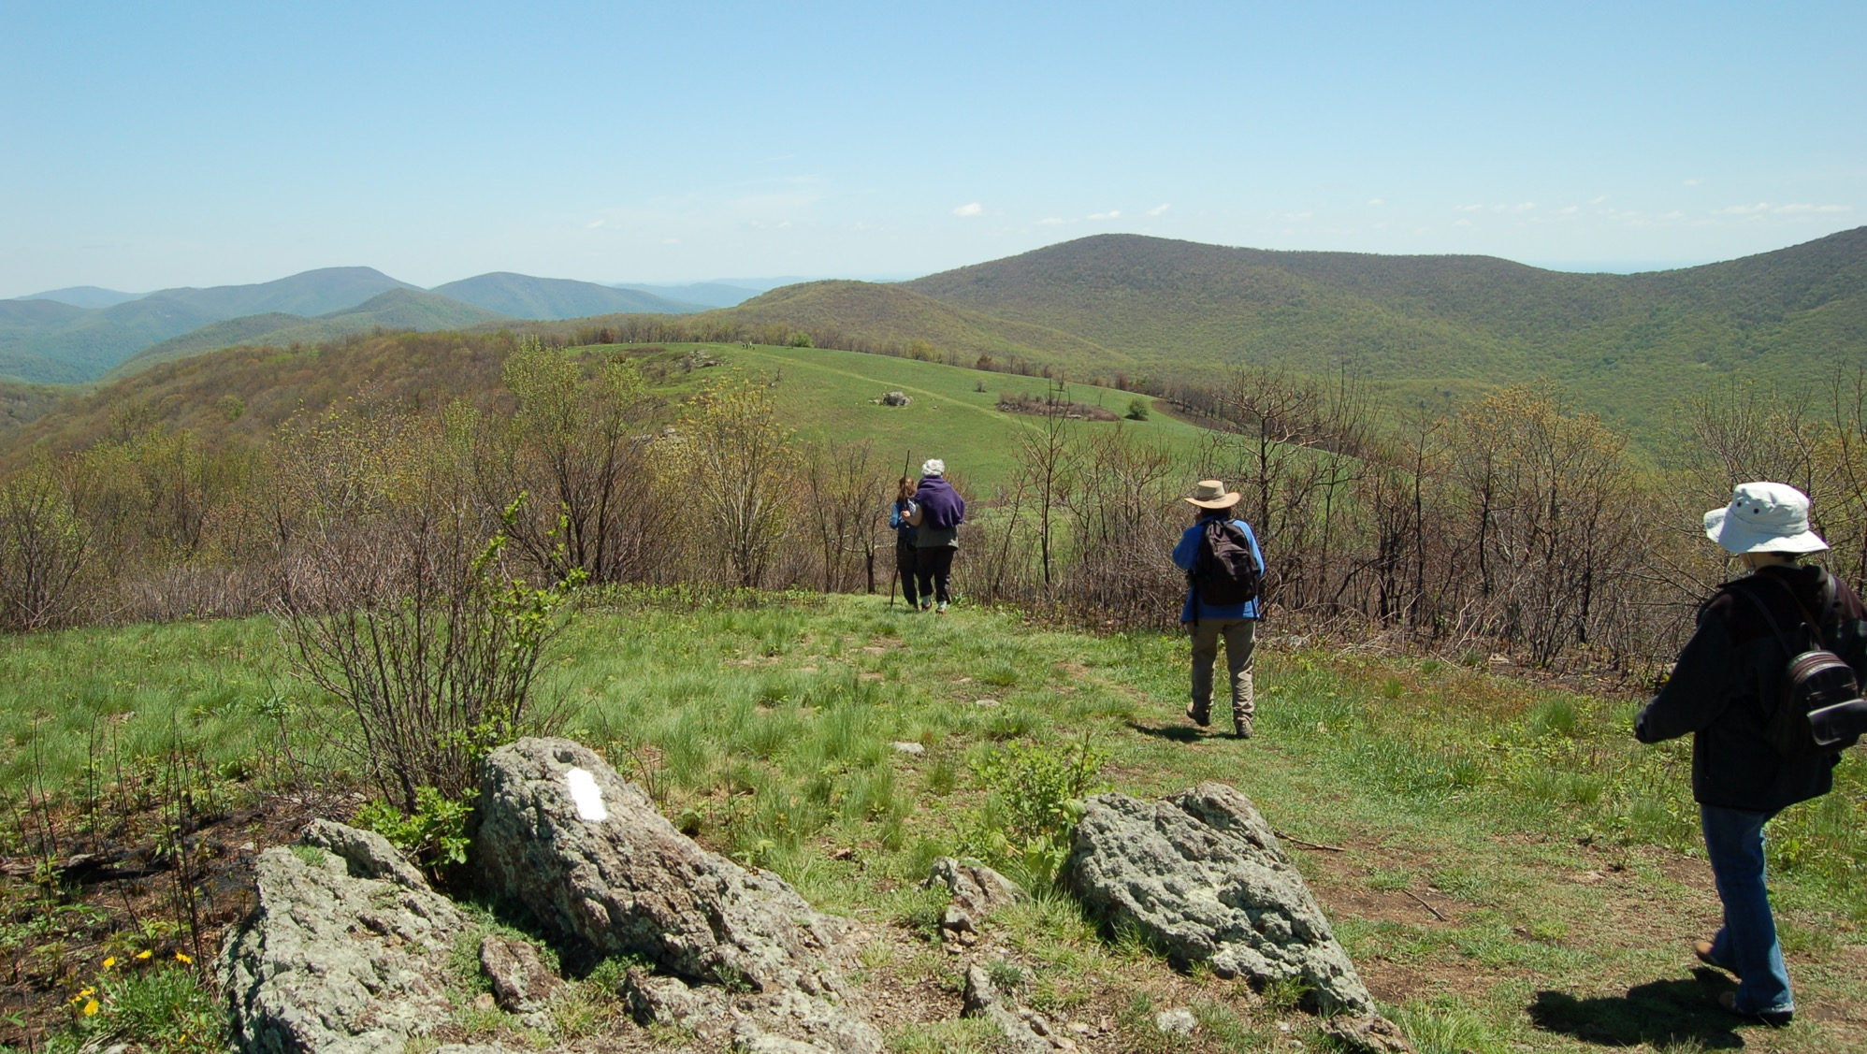

RISK MANAGEMENT
For Virginia Master Naturalist Volunteers
what you need to know
John Stanley
Notes:
Welcome to Part One of the Risk Management Presentation for Virginia Master Naturalist volunteers!
Image: Cold Mountain Hike at 2009 VMN Advanced Training Rally
Author: John Stanley
Source: VMN photo database (Alleghany Highlands)
Usage: Available for VMN state program use

Slide 2
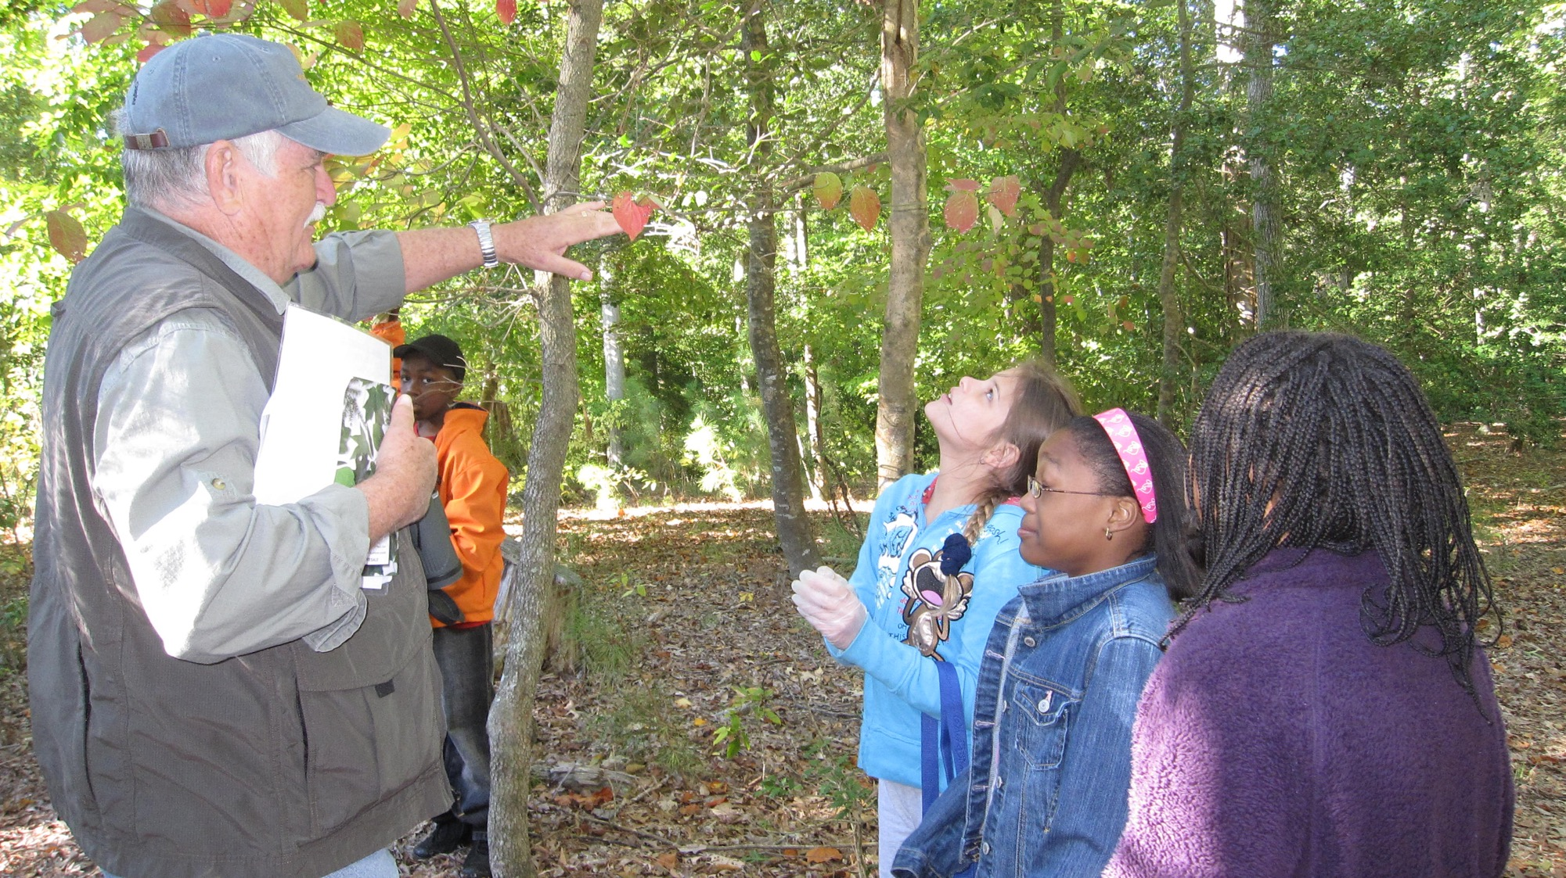
TEACHING YOUTH
Lisa Deaton
Notes:
Every day, Virginia Master Naturalists are engaged all over our state in a wide variety of activities. They could be out in the woods teaching youth about the wonders of nature,…
Image: VMN volunteer with field trip for students at New Quarter Park
Author: Lisa Deaton, DOF
Source: VMN photo database (Historic Rivers Chapter)
Usage: Available for VMN state program use. The school’s teacher confirmed that she had photo releases for all youth.

Slide 3
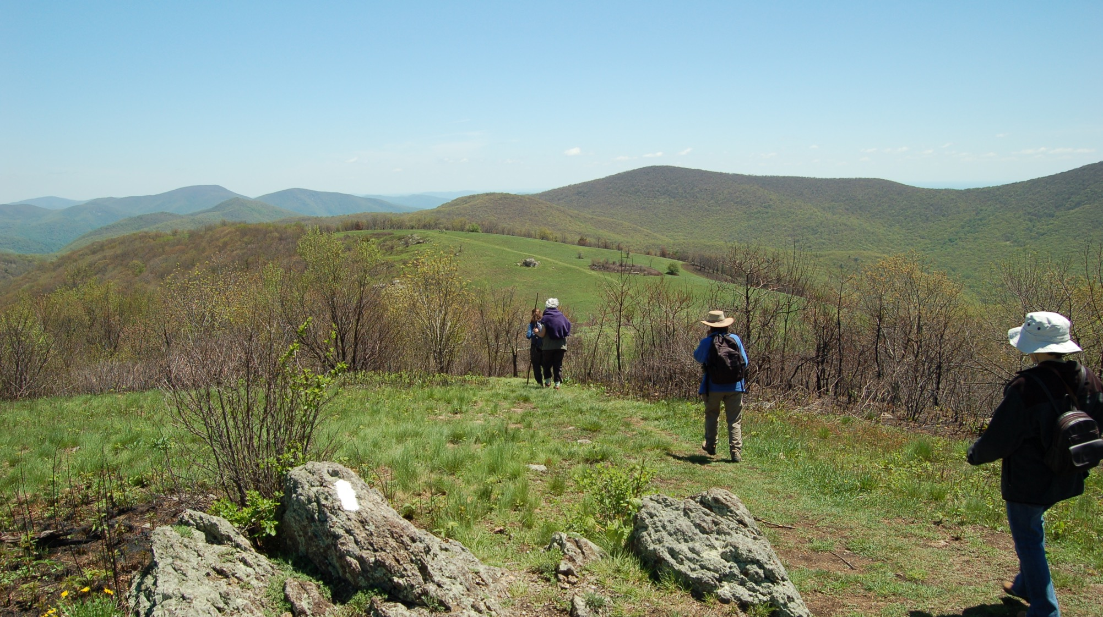
3
Images are a great tool
for showing context
BACKCOUNTRY CITIZEN SCIENCE
SUPPORT
  We perceive the world through
  more than our eyes and ears;
  we smell, we touch, and we taste.
      Put your audience in that place and
      provide them a point of reference;
      the imagination will do the rest.
John Stanley
Notes:
…hiking on a remote trail to retrieve a motion-sensing camera that was out to document wildlife for a citizen science project,…
Image: Cold Mountain Hike at 2009 VMN Advanced Training Rally
Author: John Stanley
Source: VMN photo database (Alleghany Highlands)
Usage: Available for VMN state program use

Slide 4
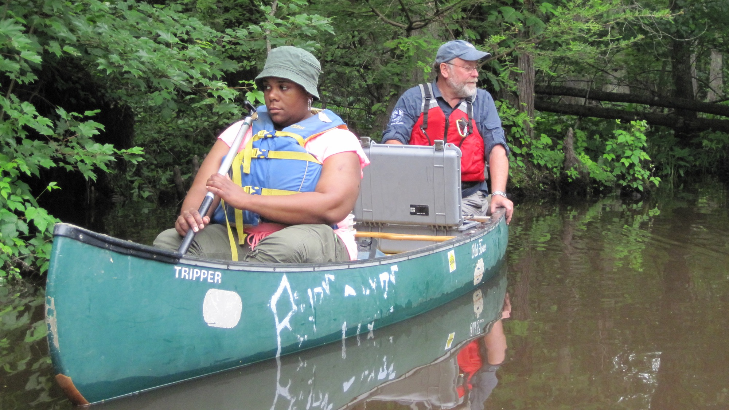
3
Images are a great tool
for showing context
SUPPORT
  We perceive the world through
  more than our eyes and ears;
  we smell, we touch, and we taste.
      Put your audience in that place and
      provide them a point of reference;
      the imagination will do the rest.
ON THE WATER
Michelle Prysby
Notes:
…paddling a canoe to gather water samples,…
Image: MWEE Training at New Kent Forestry Center
Author: Michelle Prysby
Source: VMN photo database (MWEE Leadership Institute)
Usage: Available for VMN state program use

Slide 5
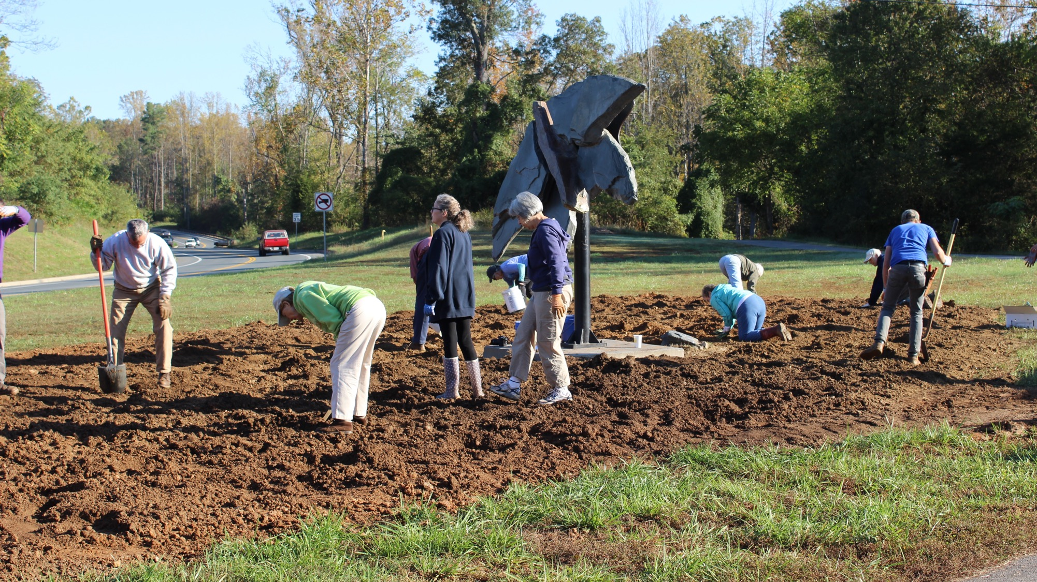
3
Images are a great tool
for showing context
SUPPORT
  We perceive the world through
  more than our eyes and ears;
  we smell, we touch, and we taste.
      Put your audience in that place and
      provide them a point of reference;
      the imagination will do the rest.
ROADSIDE PLANTINGS
Leslie Middleton
Notes:
…planting a roadside pollinator habitat,…
Image: Pollinator garden planting on the John Warner Parkway in Charlottesville, October 2015
Author: Leslie Middleton
Source: VMN photo database (Rivanna Chapter, John Warner Parkway Pollinator Project)
Usage: Available for VMN state program use

Slide 6
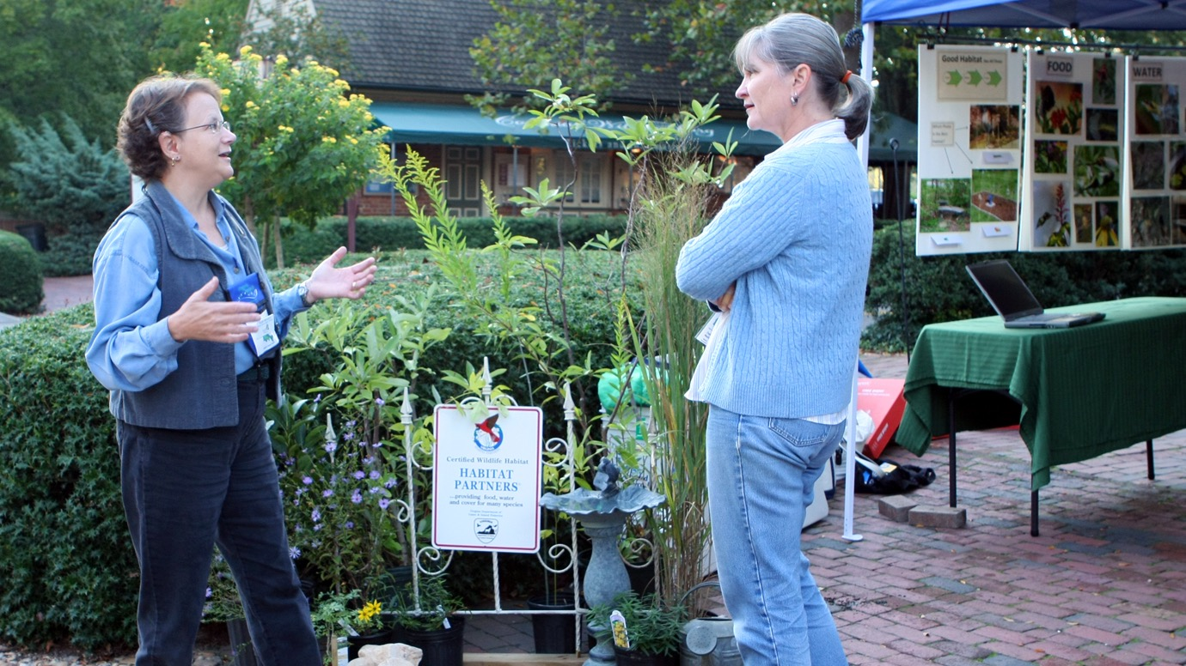
ADVISING LANDOWNERS
3
Images are a great tool
for showing context
SUPPORT
  We perceive the world through
  more than our eyes and ears;
  we smell, we touch, and we taste.
      Put your audience in that place and
      provide them a point of reference;
      the imagination will do the rest.
Felice Bond
Notes:
…educating a homeowner about invasive species, or many other activities involving education, citizen science, or stewardship!
Image: VMN volunteers discuss conservation landscaping
Author: Felice Bond, VMN volunteer (Historic Rivers Chapter)
Source: https://www.flickr.com/photos/historicrivers/8616722674/in/photolist-e8qXs3-e8khG6-e8khSM-e8qWQE-e8khvc-e8kha8-e8qWzS-e8qXmq-e8khdp-e8khDp-e8qWx3-8q9rpL-catWsW-8Y4L1K-8Y4KXT-8Y4L4k-8WN952-8Y4KBP-8Y7Ni5-8WN8kz-8WN7Zc-8WR8S5-8WR8cE-8WR8tG
License: Author’s permission

Slide 7
RISK!
To the volunteer
To other people
To property or the resource
To reputations
Notes:
Everything that Virginia Master Naturalists do involves some sort of risk. It could be risk to their own health and safety, risk to the health and safety of participants in the programs they lead, risk to property (like those new tree seedlings they are planting), or risk to the reputation of the volunteers, chapters, program, state agency sponsors, and local partners with whom they are volunteering.
(Stop here and ask audience to think about one of the previously mentioned volunteer activities, like roadside plantings, and list some of the risks associated with that activity.)

Slide 8
strategies we use to try to reduce the likelihood that some action we take will cause harm
RISK
MANAGEMENT
The responsibility of EVERY volunteer!
Notes:
Risk management means all the strategies we use to try to reduce the likelihood that some action we take will cause harm. Risk management is the responsibility of every Virginia Master Naturalist volunteer.

Slide 9
ROAD MAP
Planning Ahead
Preparing for the best…and the worst
Insurance
What’s covered, what’s not
Documentation
Keeping notes
Accidents Happen
What to do when they do
Scenarios
A walk in the woods….
Specific Risks
Youth interactions and more
Objective:
Understand aspects of risk management that pertain to your VMN volunteer role.
Notes:
In this part of the presentation, we will help you understand the following aspects of risk management:
Planning ahead and preparing
Insurance – what’s covered, what’s not
Documentation
Accidents Happen – What To Do When They Do
Some specific risk areas, such as interacting with youth
Then, we will talk about a few scenarios and have you think about possible risks and how to mitigate them.

Slide 10
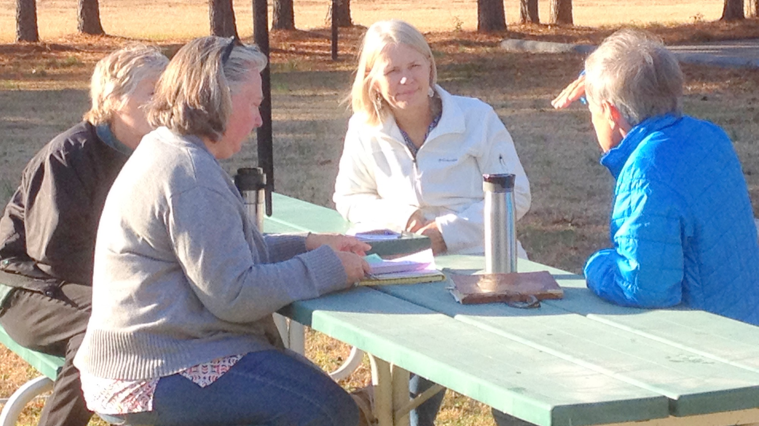
PLAN AHEAD AND PREPARE
Terri Keffert
Notes:
Your role as a VMN volunteer should include planning ahead and preparing for whatever risks are associated with the activities you are doing.
Image: 2017 Leadership Day workshop at New Kent Forestry Center, Providence Forge
Author: Terri Keffert, VMN Volunteer Coordinator
Source: VMN photo database (2017 Leadership Workshop New Kent)
License: Available for VMN state program use

Slide 11
PREPARE
Am I an organizer or leader of this activity?
No
What do I need to do to prepare myself?
Yes
Dress and pack appropriately for weather and site conditions
Understand guidelines for the activity
Know how to get help if needed
What do I need to do to prepare myself, make sure the event is safe, and minimize risks for everyone?
Notes:
A question to ask early on is, “Is this a volunteer activity that you or your chapter are leading? Or is it organized and led by another organization?” For example, VMN volunteers might participate in a stream cleanup day organized by the Nature Conservancy, help with invasive plant removal in a National Park under the direction of National Park Service employees, or teach at a Meaningful Watershed Educational Experience field day for 5th grade students organized by the local Soil and Water Conservation District. When another organization is in charge of planning the event or activity and someone from that organization is present at the event to lead it, the VMN volunteer probably is not going to be in charge of what other people are doing, but rather just for responsible for their own personal actions. In these cases, the VMN volunteer should still plan ahead and prepare to make sure they themselves are dressed appropriately for the activity, understand how to properly use any tools provided, are prepared for weather and environmental conditions, and understand and can follow the guidelines for the activity at hand.
In other situations, the VMN volunteer or chapter may be the organizers and leaders for the event. For example, if your chapter advertises in the newspaper that you are leading a family hike on a local trail, organizes a stream cleanup event for neighbors around a city park, or plans a BioBlitz and recruits members of the public to help, those are instances when the VMN volunteers are responsible not only for their own actions, but for the safety of those individuals attending the event or participating in the activity. Even if you are partnering with another organization, if you are the person who is present and leading the actual event, you are responsible for the safety of others. In these cases, additional planning and preparation by the volunteers is needed to make sure the event is safe and that risks are minimized.

Slide 12
PREPARE
Brainstorm….What could go wrong?
Review project information.
  What risks and safety procedures are already documented? Plan to follow those.
Imagine other risks.
  What are other possible risks that may not have been documented?
Identify risk management strategies.
  Make a plan to address all the risks you have identified the best you can.
Notes:
So, where to begin with that planning? A good place to start is to check any documentation for the project on which you are volunteering for any documented risks or risk management procedures. If this is an existing project or an activity that has been done before, the project description on file should identify risks and safety procedures. But, don’t stop there. Maybe you can imagine some possible risks that weren’t included in the project documentation. Once you have identified what could go wrong, plan what strategies you will use to minimize these risks.

Slide 13
PLANNING
RESOURCES
Risk Management Planning Worksheet
Risk Identification Worksheet
Field Work Risk Management Checklist
Use these resources to help you plan ahead and prepare!
All are found in the “Safety and Risk Management for VMN Volunteers” document, available at:
http://www.virginiamasternaturalist.org/risk-management.html
Notes:
There are several helpful documents for you in this planning phase. Each of these can be found in the appendices of the “Safety and Risk Management for VMN Volunteers” publication.

Slide 14
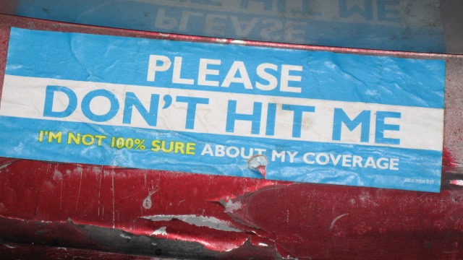
INSURANCE
Insurance Disclaimer by Andrew Steinmetz, CC BY-SA 2.0
Notes:
One of the benefits to being an enrolled VMN volunteer is access to liability coverage. Let’s look at questions of insurance in more detail.
Image: Please Don’t Hit Me bumper sticker
Author: Andrew Steinmetz
Source: https://www.flickr.com/photos/andosteinmetz/2901325908
License: Creative Commons CC BY-SA 2.0, https://creativecommons.org/licenses/by-sa/2.0/

Slide 15
INSURANCE
VMN Volunteers and Insurance
Liability Coverage
Health
Automobile
Notes:
We are going to look at three types of insurance and how they do or do not apply to VMN volunteers. Let’s start with liability coverage.

Slide 16
LIABILITY COVERAGE
A benefit for enrolled VMN volunteers
Where does it come from?
  Provided because the VMN program is part of Virginia Tech and Virginia Cooperative Extension, agencies of the Commonwealth of Virginia.
What is it?
  Protection against claims (lawsuits) resulting from injuries to people or damage to property
Conditions
  Applies to currently enrolled volunteers only (trainee, VMN member, Certified VMN)
  Applies only when doing approved activities
  Does not cover criminal activity nor intentional misconduct.
Notes:
Liability coverage protects you, the volunteer, if a lawsuit results from injuries to other people or damage to property caused by your negligent actions. It’s provided because the Virginia Master Naturalist program is part of Virginia Tech and Virginia Cooperative Extension, agencies of the Commonwealth of Virginia. It’s important to remember that the liability coverage only applies to currently enrolled VMN volunteers while they are engaged in approved VMN volunteer activities. It does not cover criminal activity or intentional misconduct, and it does not cover former VMN volunteers who have been moved into inactive status.
Sometimes volunteers get very focused on exactly who would be liable in some sort of hypothetical incident. Oftentimes, that is something that would be decided in a court, when there are specific details about a real incident. Instead of focusing on that, focus your attention on what you can do to make sure the activities you are doing are safe for yourself and for others.

Slide 17
INSURANCE
VMN Volunteers and Insurance
Liability
Health
Automobile
X
Notes:
Know that your own injuries are your responsibility. As a VMN volunteer, you are not eligible for worker’s compensation and are not provided with state health insurance. If you are injured during while participating in a VMN activity, you will need to pay any medical costs out-of-pocket or with your own health insurance.

Slide 18
INSURANCE
VMN Volunteers and Insurance
Liability
Health
Automobile
Personal insurance is primary
Notes:
In Virginia, auto insurance typically follows ownership of the vehicle. The vehicle owner’s personal automobile coverage will be primary. However, if ordered by the courts, coverage from the Commonwealth of Virginia Automobile Liability Program may be treated as excess coverage in the event the individual’s own primary insurance is exhausted. The volunteer would have to be participating in a documented and approved volunteer activity to access this potential coverage.

Slide 19
INSURANCE
Non-VMNs
& Other Organizations
Liability
Health
Automobile
X
X
X
Notes:
If there are people who are not enrolled Virginia Master Naturalist volunteers attending programs that you are organizing, they are not covered by any state liability, automobile, or health insurance. They do have access to the Commonwealth of Virginia tort claims process if they feel the volunteer VMN is responsible for their loss or injury.

Slide 20
Need a Certificate of Insurance? Contact VMN State Office or follow the directions in your handbook.
INSURANCE
Virginia Tech cannot name other organizations as “additionally insured.”
Notes:
If another organization asks for a Certificate of Insurance, contact our office and we can walk you through the process for obtaining that. Allow at least two weeks. Also, if there is a contract that needs to be signed, that must be done first, before requesting the Certificate of Insurance, and could add several weeks to the process. We’ll talk more about contracts later on. Note that Virginia Tech and the state are never able to name other organizations as “additionally insured.”

Slide 21
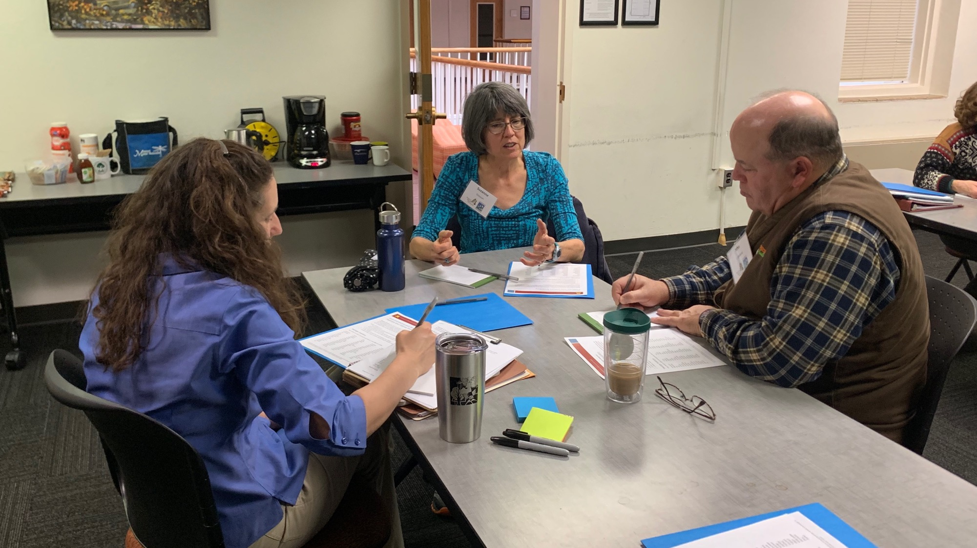
DOCUMENTATION
Jennifer Gagnon
Notes:
Good documentation is part of risk management.
Image: EmpowerU workshop in Blacksburg, 2019
Author: Jennifer Gagnon, VCE/VT
Source: Author
License: Available for VMN State Program Office use

Slide 22
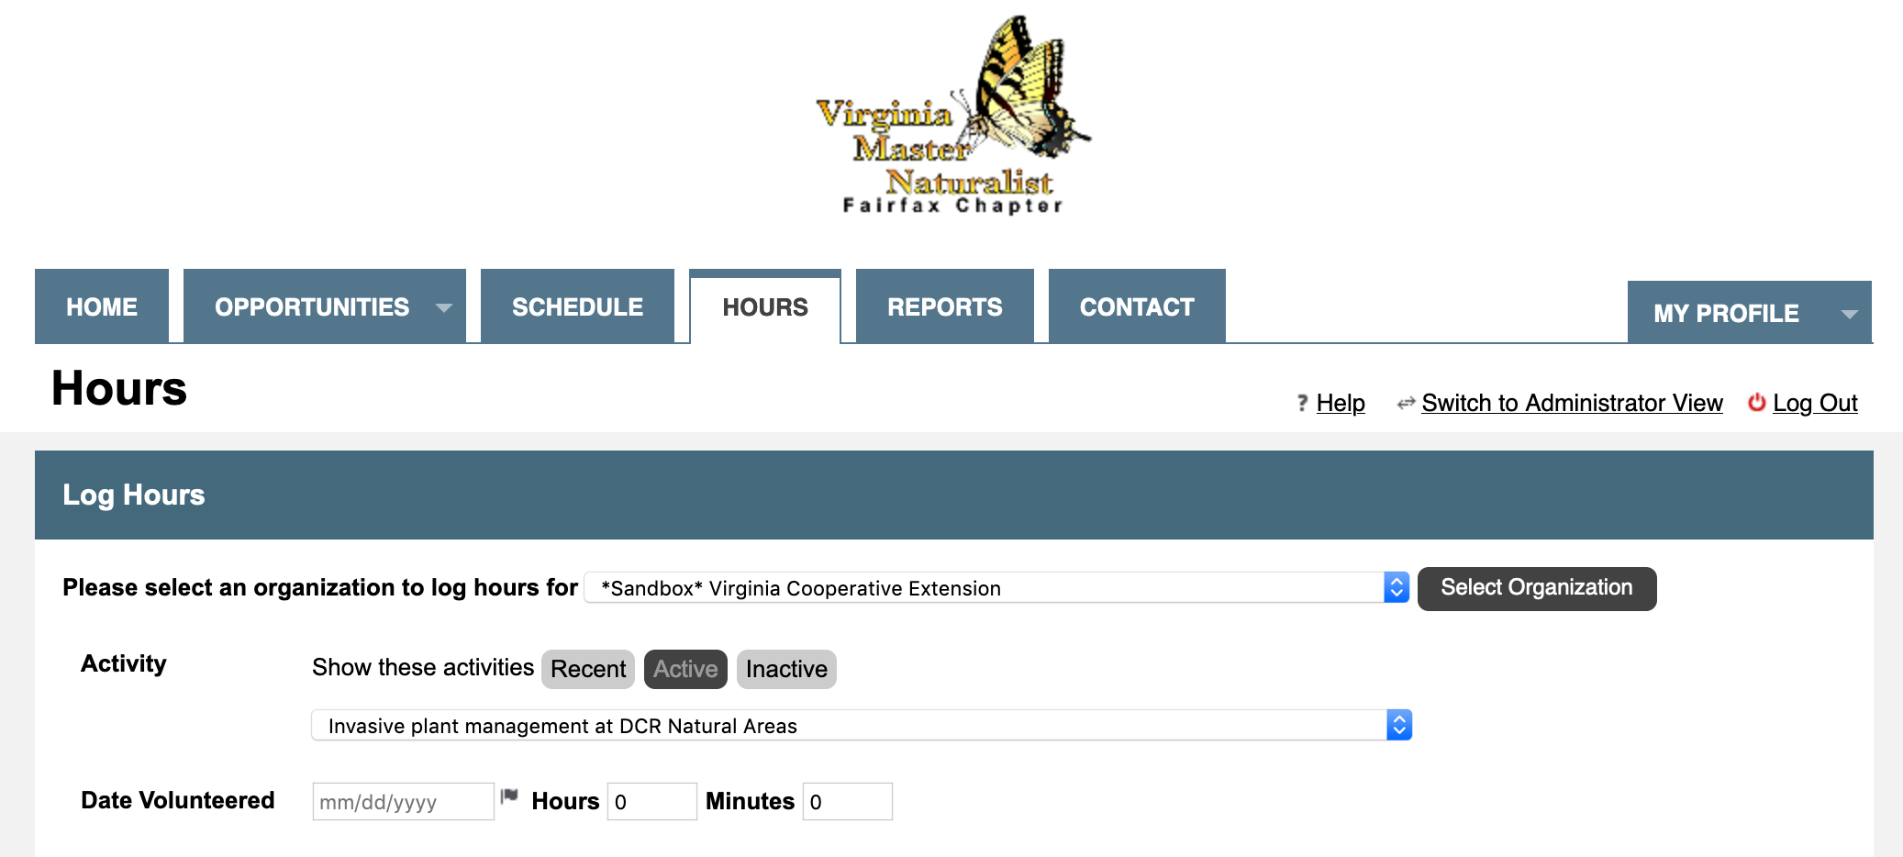
DOCUMENTATION
Select the right activity
Report your hours soon after doing them
Notes:
Be sure to document what you are doing. Report your volunteer time into the Better Impact Volunteer Management System as soon as possible after completing it. The Better Impact Volunteer Management System is the documentation of when you were acting in a Virginia Master Naturalist role. Please don’t wait until the end of the year to document your activities there!
Especially when you are leading or organizing an activity, keep personal notes to document your responsibilities toward other people and that you have assessed the potential risks and planned accordingly.
Documentation also includes using the incident report form, which we will talk more about in a moment.

Slide 23
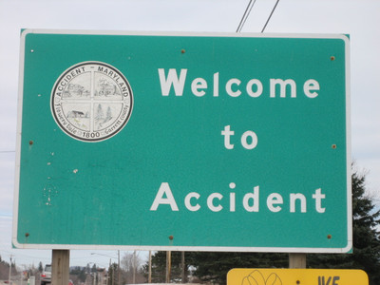
WHEN ACCIDENTS HAPPEN
WeWereThere.sized by Patty, CC BY 2.0
Notes:
Accidents do happen. Let’s say you’ve done all the preparations we’ve just described and followed all the risk management guidelines, but something still goes wrong. Perhaps someone gets injured or perhaps there is damage to property. What do you do?
Image: “WeWereThere.sized”
Source: https://www.flickr.com/photos/pattista/105940092/
Author: Patty
License: CC BY 2.0, https://creativecommons.org/licenses/by/2.0/

Slide 24
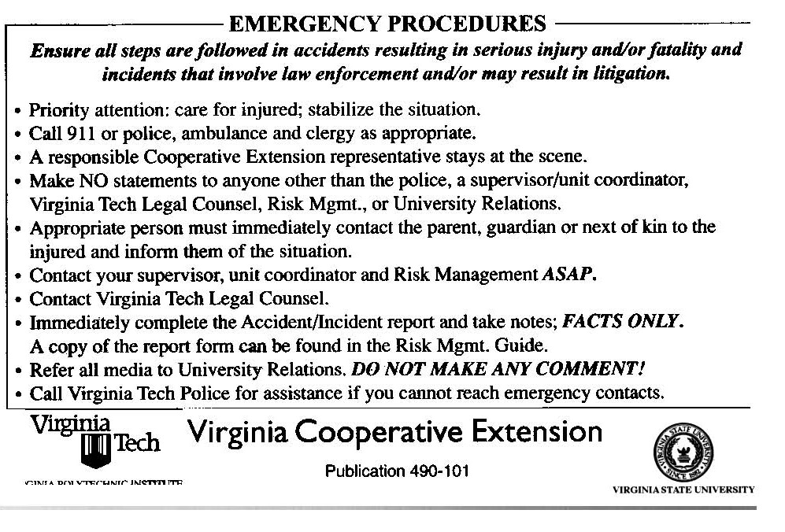
WHEN ACCIDENTS HAPPEN
Emergency Procedures Card
    Carry with you and follow the directions.
Notes:
If there were to be a very serious emergency, sometimes it is easy to feel panicked. For this reason, Virginia Cooperative Extension has created the Emergency Procedures Card. Every VMN volunteer should carry this card when volunteering. This card is to be followed in the event of emergencies involving very serious injuries and incidents that involve law enforcement. On one side of the card, it has reminders of what to do in the event of a very serious emergency. You should call 911. You should make sure a responsible Cooperative Extension representative, which could include yourself or another VMN volunteer, stays at the scene. You should contact your chapter advisor, who is your supervisor for the purposes of these procedures. You should not make any statements to the media or to anyone else outside of your chapter advisor, the police, or the Legal Counsel, Risk Management, or University Relations offices at Virginia Tech.

Slide 25
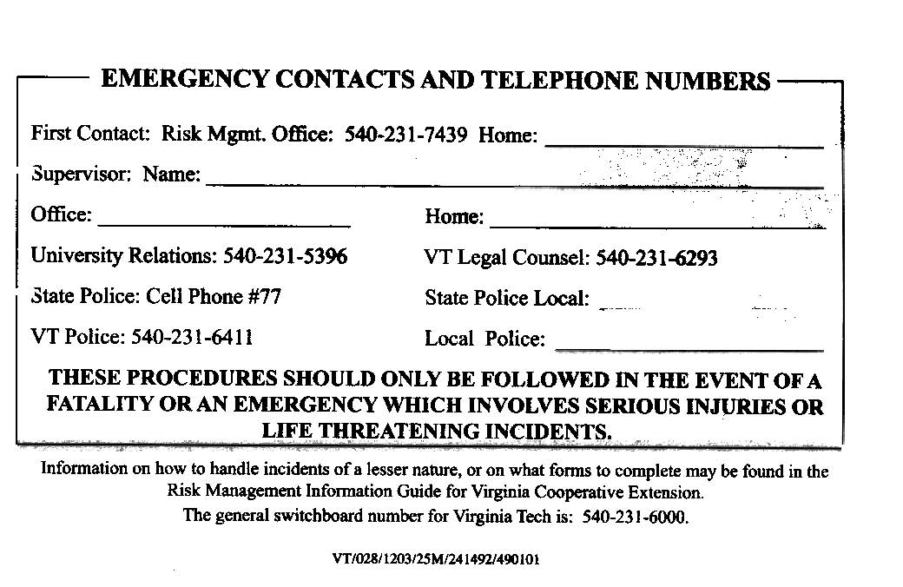
WHEN ACCIDENTS HAPPEN
Emergency Procedures Card
    Fill in the necessary contacts.
Notes:
On the other side of the card, there are places for all the contact information you might need. Again, your chapter advisor is your supervisor in this case, so please put his or her name and contact information in those blanks. Ask that person for the best number to use to reach them in an emergency. Fill in the numbers for your local police, though remember you would first call 911 in an emergency. If you frequently volunteer at specific locations or with specific local partners, you may want to add contact information for these partners as well. For example, if you volunteer a lot in a National Park, you will want to write down the park’s emergency contact number.

Slide 26
WHEN ACCIDENTS HAPPEN
Incident report form.
    Complete after serious incidents.
Notes:
Please carry the incident report form, and make sure it is completed it in the event of an accident that is more serious than just a small cut, scrape, or bruise. Include only the facts. Make sure that both your chapter advisor and the VMN State Program Office receive a copy of the completed form.

Slide 27
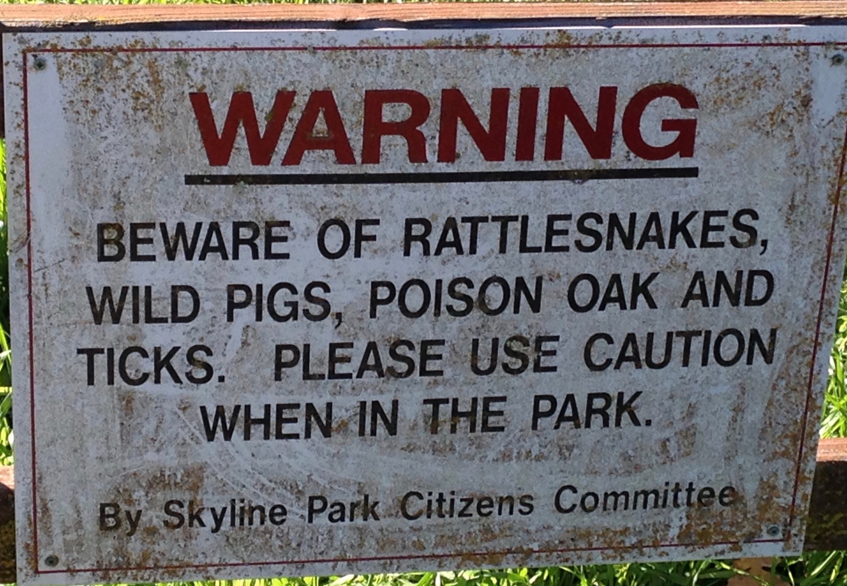
SOME SPECIFIC RISKS
Warning! by Melinda Young Stuart, used with permission
Notes:
It’s not within the scope of this training to go over every single risk you might encounter and identify what you should do, but there are a few specific risks that we do need to talk about.
Image: “Warning!”
Author: Melinda Young Stuart
Source: https://www.flickr.com/photos/melystu/37292580974
License: CC BY-NC-ND 2.0, https://creativecommons.org/licenses/by-nc-nd/2.0/legalcode, but we got e-mailed permission from the author to use it for this presentation (because it is a derivative work, so not covered by the CC license.)

Slide 28
SPECIFIC RISKS
General Personal Protection
General Care for Others
Interacting with Youth
Weather and Environmental Hazards
Contact with Plants and Wildlife
Field Etiquette, Rules, and Laws
Information, Protocols, and Scientific Integrity
Administrative Risks
Review the handout on risks and associated strategies and policies.
Notes:
Review the Safety and Risk Management handout for details on all of these kinds of risks. We’ll talk here about just three of these areas of risk.

Slide 29
YOUTH
VMN Volunteers Working with Youth
Report Suspicions of Abuse
Take Actions to Remain Above Suspicion
Work with Partner Organizations
Notes:
As a VMN volunteer, you might be interacting with youth in several different capacities. There are several youth-specific aspects of risk management that apply across the board, and we will go over those here.

Slide 30
YOUTH
Reporting Suspicion of Child Abuse
Suspicion
  Suspicion means reasonable cause to believe that an individual has been abused or neglected.
Mandatory Reporters
  Anyone involved in the “education or care of children” is a mandatory reporter.
What To Do
  Report it to Social Services within 24 hours.
  Hotline #: 1-800-552-7096
  If during the process, you feel your safety or the safety of others is in jeopardy, call the police.
  Let your chapter advisor and the VMN state program office know about the report.
  Maintain confidentiality.
Notes:
In the Commonwealth of Virginia, there are some individuals who are considered “mandatory reporters.” This includes anyone involved in the education or care of children. All Virginia Cooperative Extension faculty are mandatory reporters, and so are all VCE volunteers who are working with youth (including VMNs.) What that means is that they have the responsibility to report any allegation, accusation, or suspicion of child abuse or neglect. What that means for you is that, in your work as a VMN volunteer, if you are working youth and you have any suspicion or have heard anything that made you question the safety of that youth or that made you think there could be possible abuse or neglect, it is your responsibility to report it. This typically would happen if you were interacting with the same youth over a length of time. If you are volunteering at a festival, and you have youth coming to a table for just a short period of time, this is probably not something that would even come up. It is just something we want you to be aware of so that you know to report. Be aware of confidentiality! If you hear something or have a suspicion, it is not your job to investigate. Your job is just to report it to three places—the reporting hotline, your chapter advisor, and the VMN state program office. It is not something that you should discuss with other volunteers, because we want to maintain the confidentiality of that youth and their family.

Slide 31
YOUTH
Remaining Above Suspicion
Why?
  To protect yourself, the youth, and our program and its sponsors.
What To Do
  When working with children, always be in groups of 3 or more.
  Have at least two adults present for events and programs with youth.
  Anticipate scenarios and plan ahead to avoid one-on-one interactions.
Notes:
For the protection of yourself, youth, and the entire VMN program and its sponsoring agencies, it’s critical that you remain “above suspicion” yourself. This means when you are working with youth, always remain in groups of at least three people. You want to avoid one-on-one situations with youth. It’s best, if you are working at an event or a program with youth present, that you always have at least two adults working together with that group of youth. You want to think about the kind of scenarios that could happen so that you can plan ahead to avoid being one-on-one. How many youth will be there? What if some kids need to go to the bathroom? What if a parent is late to pick up their child?

Slide 32
YOUTH
Work with Partner Organizations
Share the Responsibility
  Have representatives from the partner organization there to provide oversight of the youths’ safety and participation.
Work with a Partner Organization
  Is there a partner organization that regularly works with youth that can provide oversight and assistance?
Use Research-based Curricula
Examples:
4-H
Project Learning Tree
Project Wild
Project Wet
Virginia State Parks Backyard Classroom
Notes:
When working with youth, make sure of who is in charge, and, when possible, have another organization provide the oversight and main care of the youth. This allows you to focus on the programming, rather than managing behavior, and it puts less responsibility on you as a volunteer. Some of the partner organizations you might work with include 4-H, school divisions, public libraries, Virginia State Parks, local parks and recreation departments, Boys and Girls Clubs, and others.
When working with a group like this, ask the teachers, parents, or educational staff ahead of time to be in the classroom or activity so that they can be the person in charge of the youth. If you are the only adult, then you become the sole person in charge of those youths’ safety and the sole person with duty of care. If you anticipate doing an independent program like that, you may need to go through additional training and screening with the 4-H program.
When you are doing a program with youth, you want to ensure that you are using research-based curriculum. 4-H and Cooperative Extension have many curricula that you can access. Environmental education curricula are a great option. These include Project Learning Tree, Project Wet, Project Wild. These are excellent trainings to take. They are typically one day, and you end up with a book full of all kinds of lessons for teaching youth about the environment. You want to make sure that what you are doing with youth is research-based, tested, and also experiential.

Slide 33
INFORMATION, PROTOCOLS, SCIENTIFIC INTEGRITY: RESEARCH-BASED INFO
Provide only accurate, unbiased, research-based information in educational programs and outreach materials.
When volunteering, VMNs are representing the Commonwealth of Virginia and our sponsoring state agencies.
Do not engage in political advocacy while acting in a VMN capacity.
Do not use the VMN program to promote a biased personal agenda.
Use information from our sponsoring agencies as a guide.
Notes:
Virginia Master Naturalists should share only research-based, unbiased, accurate information in their educational programs and materials. This program is not the right platform for political-type advocacy or promoting a biased personal agenda that doesn’t match the information from our sponsoring agencies.

Slide 34
ADMINISTRATIVE RISKS: CONTRACTS
We don’t want volunteers to end up being personally liable.
VMN volunteers are not authorized to sign contracts on behalf of the program or the sponsoring agencies.
Contracts can include room rental agreements, group agreements with other organizations and local governments, transportation agreements, etc.
Contact the VMN State Program Office for assistance. Contracts will be routed through us to Virginia Tech Legal Counsel.
Allow plenty of time!
Notes:
Only individuals authorized by Virginia Tech can sign contracts on behalf of the Virginia Master Naturalist program. VMN volunteers are not authorized to sign contracts for the program or our sponsoring agencies. Doing so could result in a volunteer being personally liable for something. There are many kinds of contracts you might encounter, such as room rental agreements, group agreements with other organizations, transportation agreements, and more. Please contact the VMN State Program Office for assistance. We will route the contract through to Virginia Tech Legal Counsel for review and routing to the authorized signee. You will need to allow plenty of time—at least a month! The process can take a long time, especially if the other entity has things in the contract that Virginia Tech cannot agree to (such as extending our liability insurance over another organization.)

Slide 35
SPECIFIC RISKS
General Personal Protection
General Care for Others
Interacting with Youth
Weather and Environmental Hazards
Contact with Plants and Wildlife
Field Etiquette, Rules, and Laws
Information, Protocols, and Scientific Integrity
Administrative Risks
Review the handout on risks and associated strategies and policies.
Notes:
Remember, we have only talked about a few categories of risk in this presentation, and there are others! Be sure to read through the handout.

Slide 36
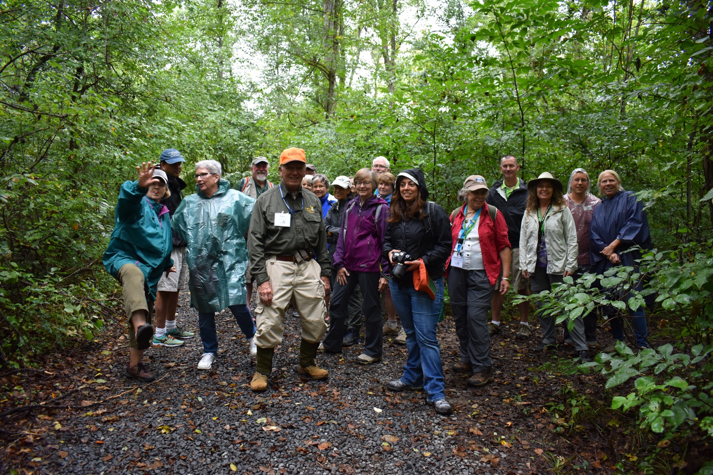
SCENARIO: A WALK IN THE WOODS
VMN volunteer
Notes:
Let’s apply what we have talked about to a scenario. Imagine you are organizing a public nature walk in a county park. How might you plan ahead and prepare?
Your first question - Are you the leader, or is a different organization going to be there leading the event? You’re the organizer and the main leader. That means it is your responsibility to plan a safe and effective event.
What are the risks you might need to consider? (Audience can brainstorm here.) Some to consider include: A participant or yourself tripping, slipping, falling; a participant getting separated from the group and lost; weather-related hazards (such as very hot weather, very cold weather, thunderstorms, high winds); flora and fauna (ticks, poison ivy, E. coli in streams….)
What kinds of things should you do to prepare for these risks?
Walk the trail ahead of time to look for any issues, places where people should use extra caution, and places where the group might get separated. See if you’ll have cell phone service, and, if not, identify the closest place you can get to where you can call for help if needed.
Check the weather forecast and be prepared for the conditions.
Communicate with the participants ahead of time about what to bring and expect. If registration is required, you can contact them directly with any email. If not, you’ll want to include this information in your advertising of the event. Depending on the trail and weather conditions, you might want to ask them to wear closed-toed shoes and long pants, sunscreen, a hat, and/or rain gear. Depending on the conditions and the activity, you may want to ask them to bring water, snacks, insect repellant, and/or additional clothing layers.
Point out poison ivy so that participants know to avoid it. Remind everyone to use precautions to avoid ticks, and to check for ticks when they get home.
Have a second leader present to act as the “sweeper” at the back of the group, making sure that no one gets lost.
Image: VMN conference field trip, 2018
Author: Unknown conference attendee
Source: VMN photo database
License: Submitted for VMN program use

Slide 37
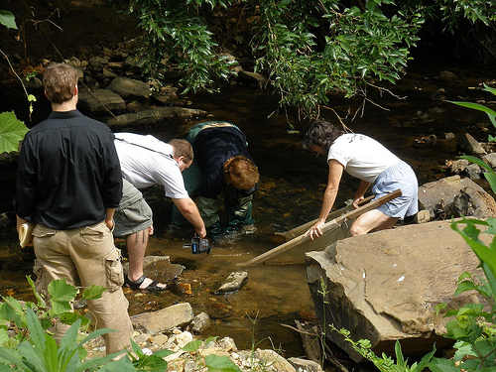
SCENARIO: STREAM STUDY
Rose Brown
Notes:
OK, new scenario. You have signed up for a project to help your local Watershed group do biological monitoring of a local stream.
Are you the organizer, or is a different organization planning this event? Another organization (the Watershed group) oversees the overall project and defines the protocols, but your monitoring is done on your own, not with the whole group, and you can choose when to go. That means it is up to you to make sure you keep yourself safe.
What are the risks you might need to consider? (Audience can brainstorm here.)
Be sure to mention wildlife permits, landowner permissions.
What kinds of things should you do to prepare for these risks?
Image: StreamWatch
Author: Rose Brown, former VMN in Rivanna Chapter
Source: VMN photo database
License: Submitted for VMN program use

Slide 38
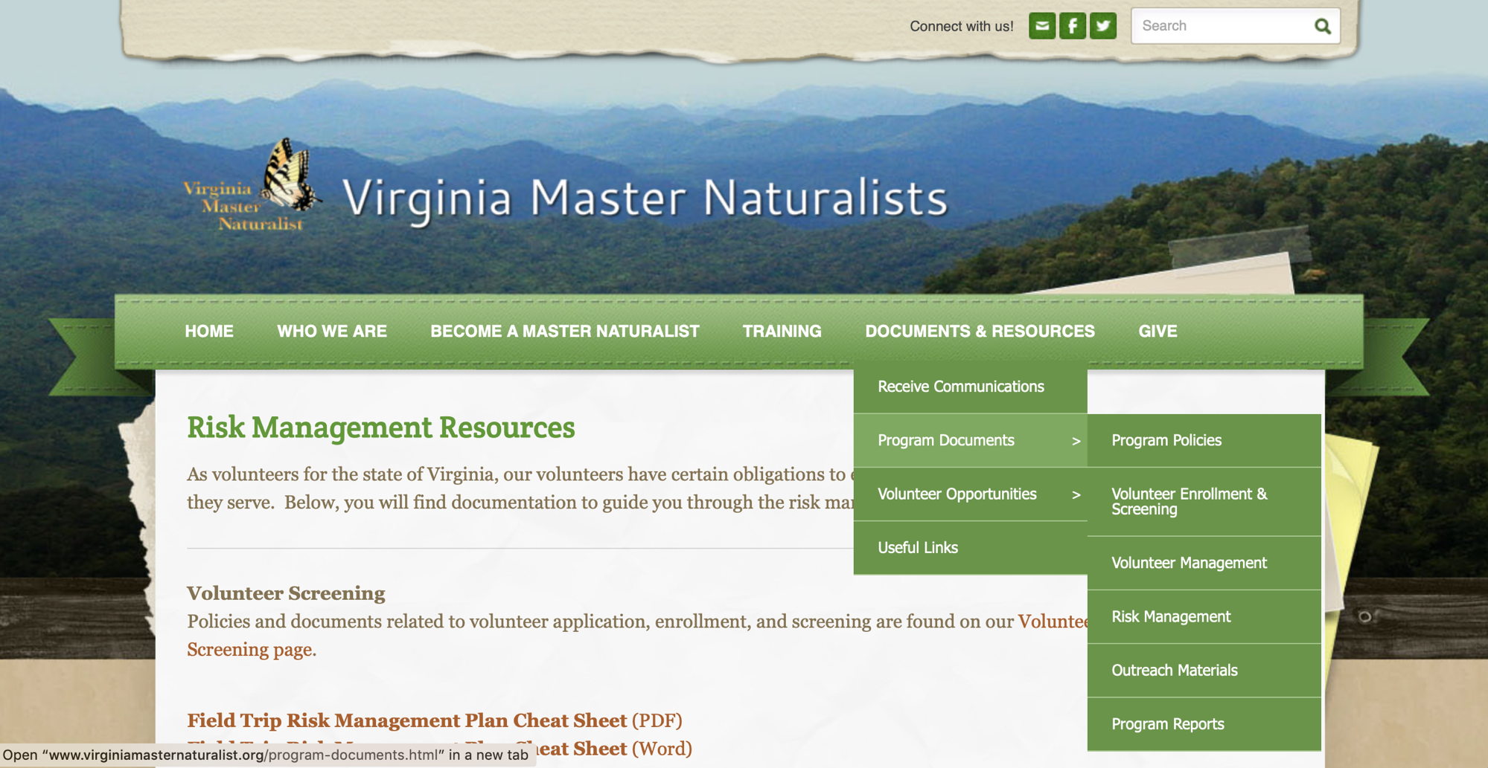
Notes:
You can find all the training materials, forms, and other information related to risk management on the Virginia Master Naturalist website.

Slide 39
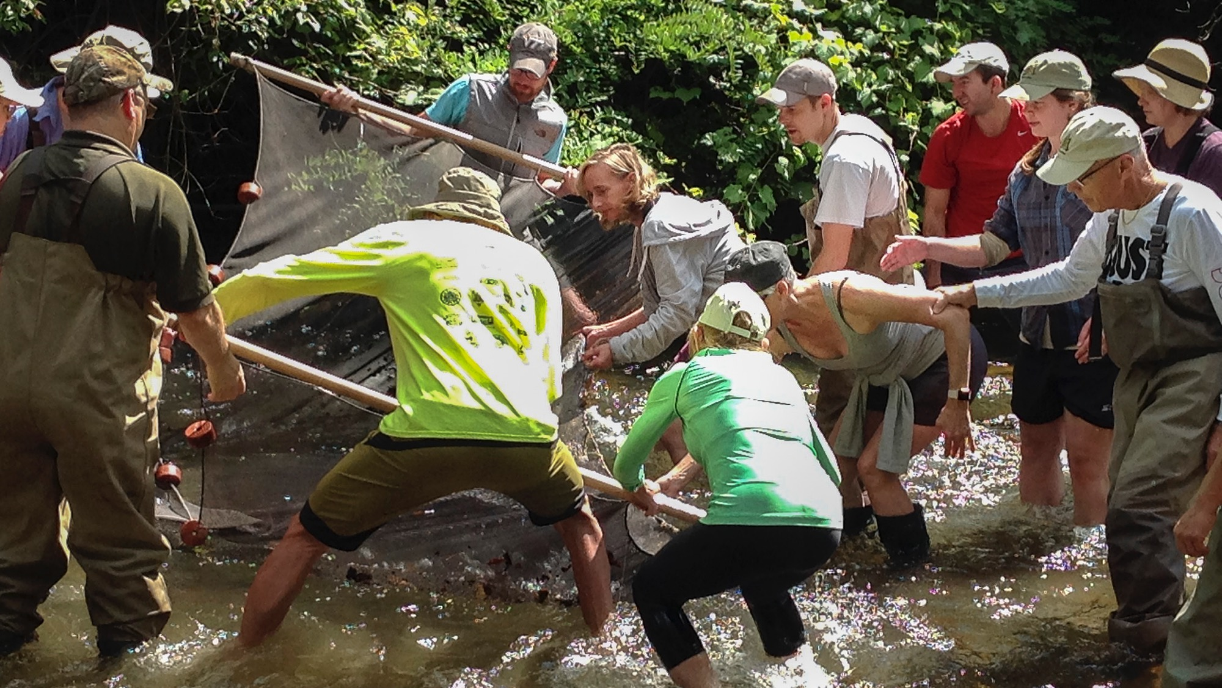

THANK YOU
For being a Virginia Master Naturalist Volunteer!
Dianna Bridges
Notes:
Thank you! With everyone doing their parts, we can keep our program safe and successful!
Image: Stream monitoring
Author: Dianna Bridges
Source: author (photo contest)
Usage: Available for VMN state program use

