Slide 1
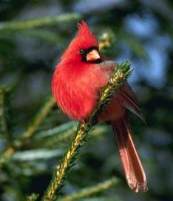
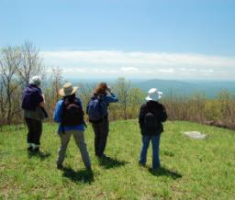
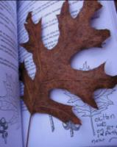
Volunteer educators, citizen scientists, and stewards helping Virginians conserve and manage natural resources and public lands
Notes:
Welcome! Thank you for your interest in becoming a Virginia Master Naturalist! Today, my role is to make sure you understand the background and expectations of the program, so that you know what you’ve gotten yourself into.

Slide 2
Introductory Class Objectives
Describe what a Master Naturalist volunteer is
Identify and communicate the mission and goals of the Master Naturalist program
Identify and communicate the requirements and responsibilities of a Virginia Master Naturalist
Be familiar with the expected standards of conduct for Master Naturalists
Understand the role of learning as a lifelong pursuit
Understand the many possible options for volunteer service projects, including citizen science, education/interpretation, and stewardship projects

Slide 3
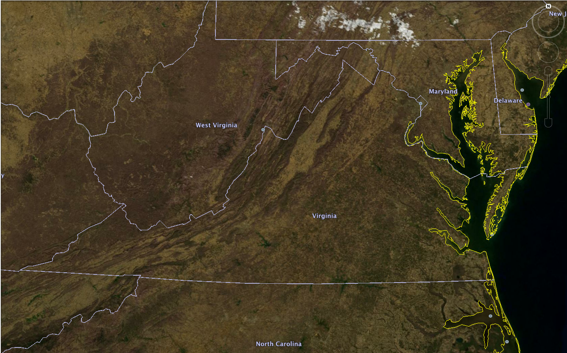
Notes:
Question: Pretend as if you were getting ready to come to class tonight when a neighbor calls you on the phone. You said, “I can’t talk right now, I’m on my way to participate in the Virginia Master Naturalist program.” Your neighbor asks, “The Virginia Master Naturalist program? What’s that?” Talk to your tablemates about how you would answer that question.
What words or phrases came up?
The Virginia Master Naturalist program is a program to benefit Virginia’s natural resources…

Slide 4
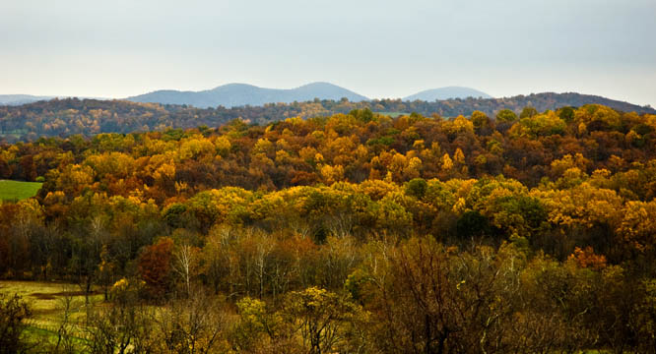
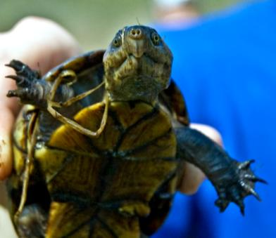
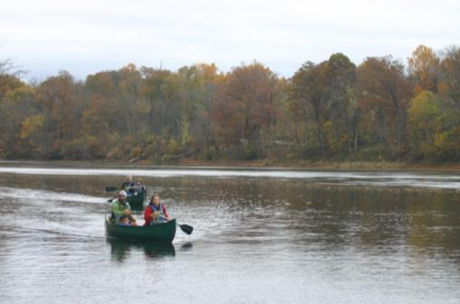
Notes:
…our woods, our wildlife, and our waters.

Slide 5
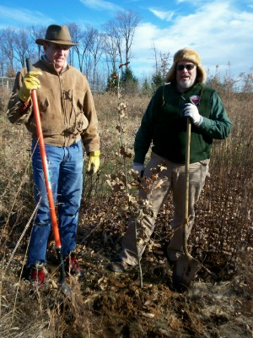
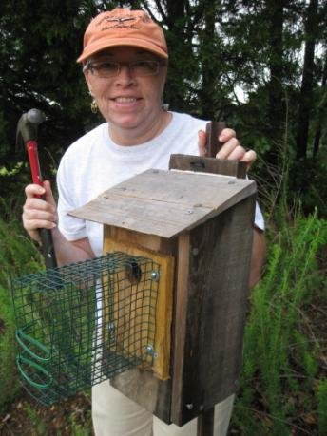
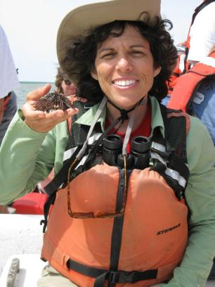
Notes:
It is a program that cultivates volunteers…

Slide 6
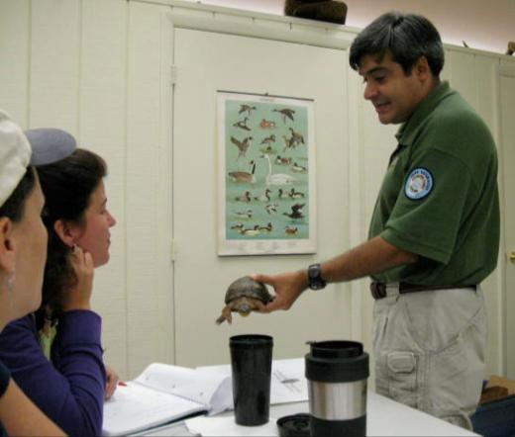
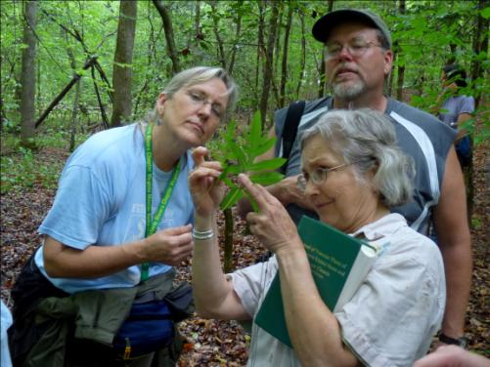
Notes:
…providing training to get the participants hooked….

Slide 7
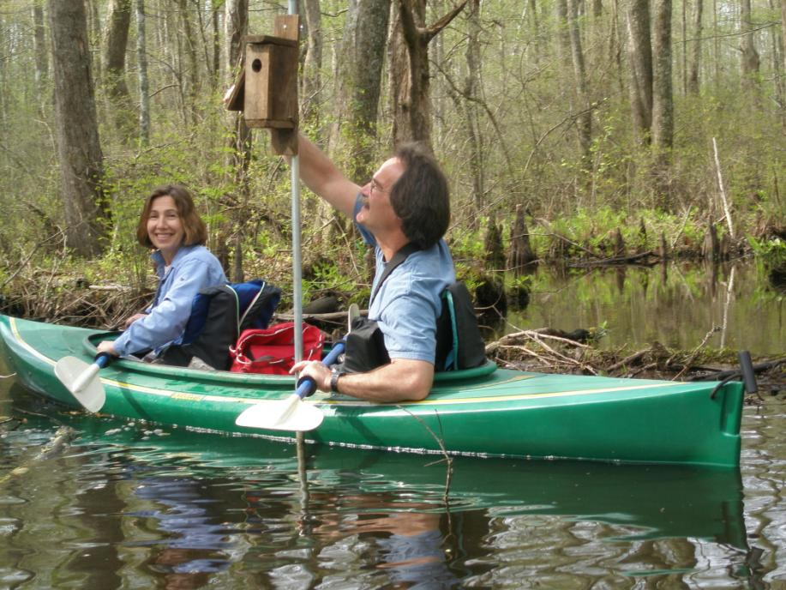
Notes:
…and then helping them find opportunities to use their knowledge and skills to benefit Virginia’s natural resources.

Slide 8
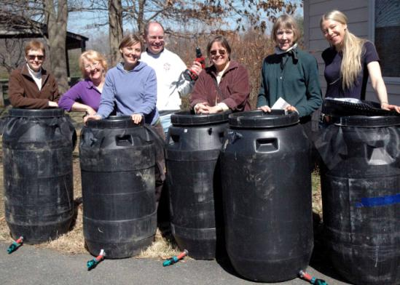
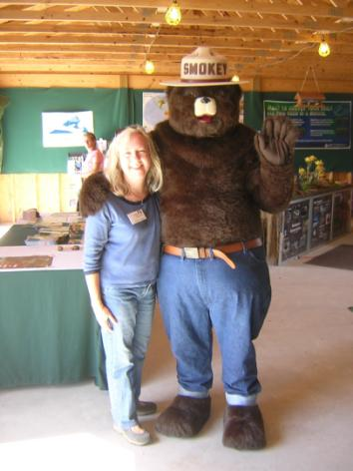
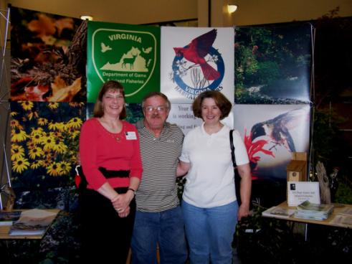
Notes:
It is a program that’s about community partnerships. Our Virginia Master Naturalist chapters become a way for many partners involved in natural resource education and conservation to work together to cultivate and engage a group of motivated and trained volunteers.

Slide 9
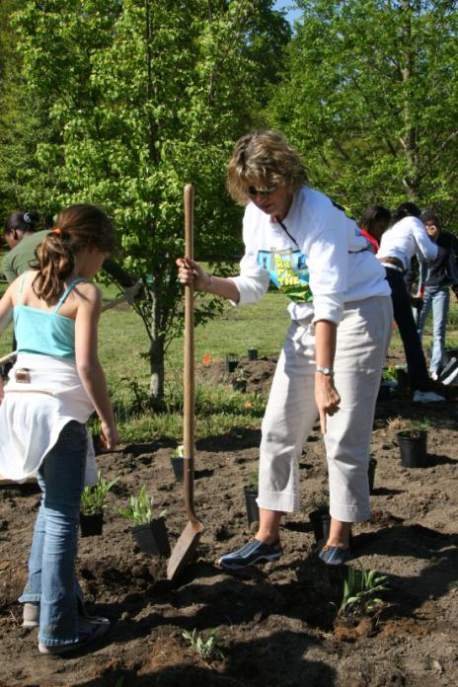
Mission:
The Virginia Master Naturalist program is a statewide corps of volunteers providing education, outreach, and service dedicated to the beneficial management of natural resources and natural areas within their communities.
Notes:
Our official mission is to be a statewide corps of volunteers providing education, outreach, and service dedicated to the beneficial management of natural resources and natural areas within their communities. The program was first launched in 2005, and has grown tremendously since then.

Slide 10
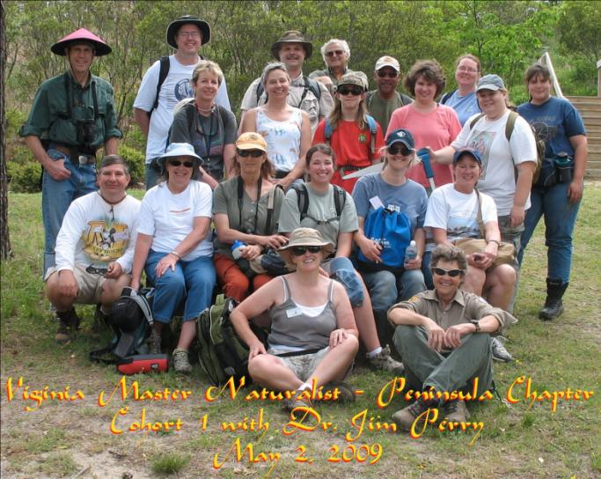
6,200+ training course graduates
Notes:
By the end of 2021, more than 6,200 people had graduated from a Virginia Master Naturalist training course.

Slide 11
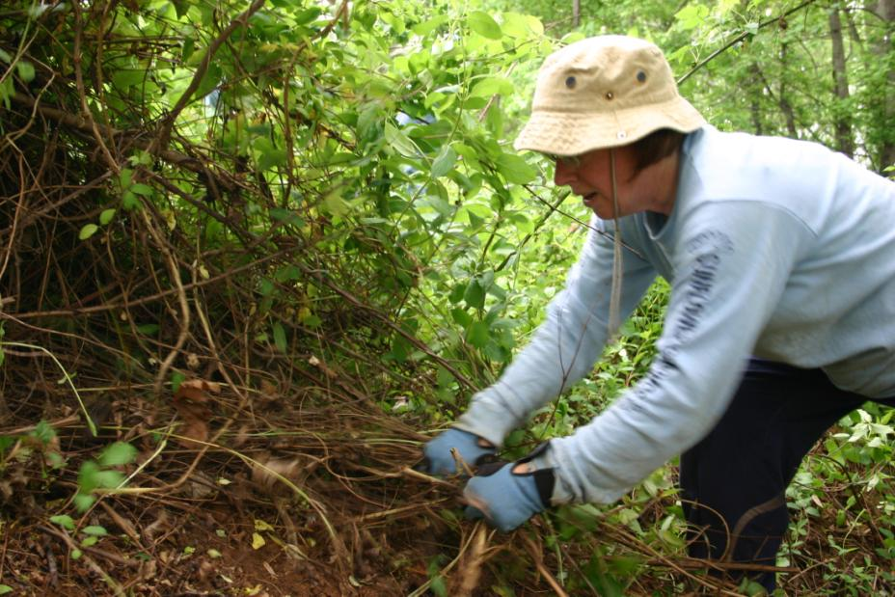
2,100 active volunteers
Notes:
In 2021, about 2,100 individuals reported doing volunteer service as a Virginia Master Naturalist. Close to 1,500 volunteers currently have the title of Certified Virginia Master Naturalist. Hundreds of volunteers have reached milestones of 250, 500, or 1,000 hours of service, and about a dozen volunteers have even completed 5,000 hours of service.

Slide 12
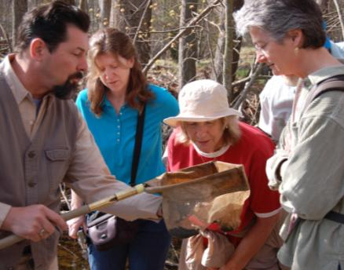
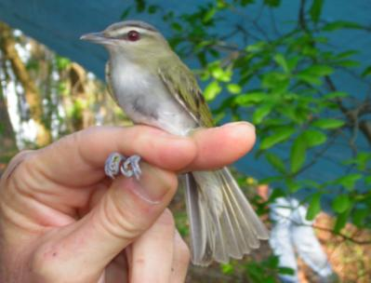
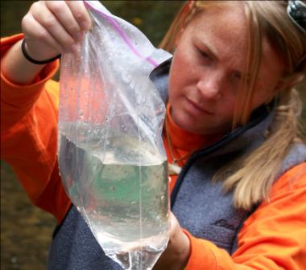
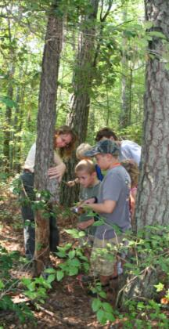
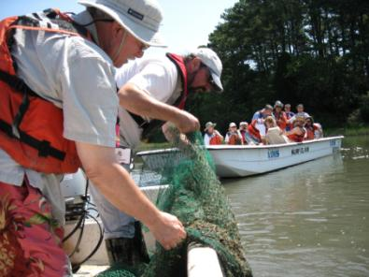
>1.6 M hours $43 M of service
Notes:
Since inception of the program, Virginia Master Naturalists contributed more than 1.6 million hours of volunteer time to benefit natural resources in Virginia, which equals more than $43 million worth of donated time.

Slide 13
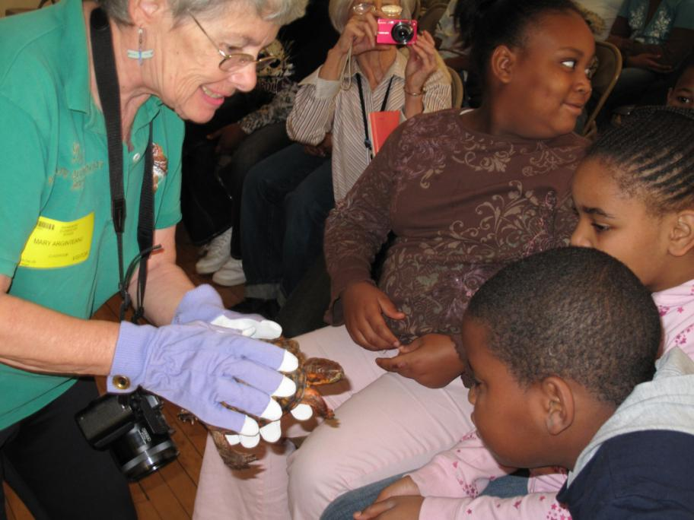
Notes:
Each year, the volunteers’ make more than 100,000 educational contacts with youth and adults. Their educational programs reach many groups of people, and our chapters are working hard to find ways to reach diverse audiences in their communities. We continue to look for ways to diversify our volunteer base as well. We want to promote the concept that nature is for everybody and that everyone is welcome and valued in our programs.

Slide 14
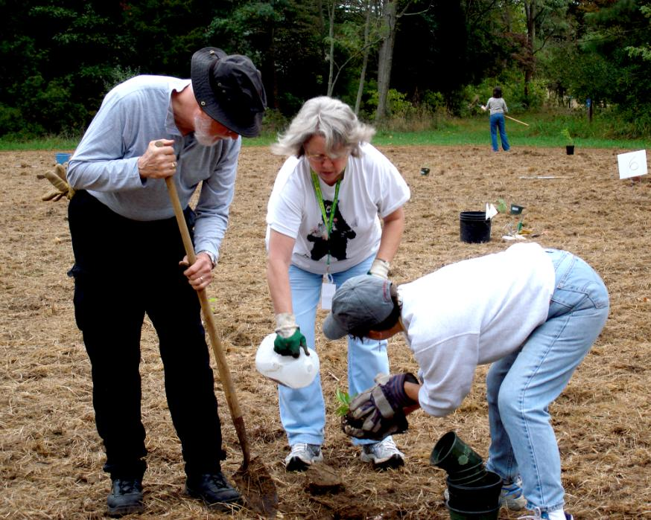
Notes:
And, their stewardship projects taking place at approximately 500 sites across Virginia, have improved at least thousands of acres of public lands and thousands of miles of trails. The volunteers in this photo are in our Historic Rivers Chapter, in Williamsburg, and they are planting habitat for bobwhite quail.

Slide 15
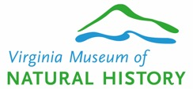
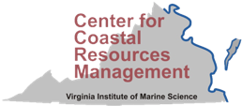
Virginia Master Naturalist Sponsors
Sponsored by 7 agencies:
Also supported by:
Notes:
There are Master Naturalist programs in many states, but Virginia’s program is unique because we have seven different state agencies that co-sponsor the program. They are Virginia Cooperative Extension, the Virginia Department of Conservation and Recreation, the Virginia Department of Environmental Quality, the Virginia Department of Forestry, the Virginia Department of Game and Inland Fisheries, the Virginia Museum of Natural History, and the Virginia Institute of Marine Science’s Center for Coastal Resources Management. The Virginia Tech Department of Forest Resources and Environmental Conservation and the Virginia Tech College of Natural Resources and Environment also support the program and house the program staff.

Slide 16
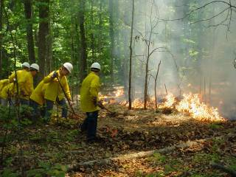
VA Department of Forestry
Mission: We protect and develop healthy, sustainable forest resources for Virginians.
Protects >16 million acres of forest land from fire, insects, and disease.
Manages 25 State Forests and other state lands totaling >69,000 acres for timber, recreation, water, research, wildlife, and biodiversity.
Provides technical advice to private forest landowners
http://www.dof.virginia.gov

Slide 17
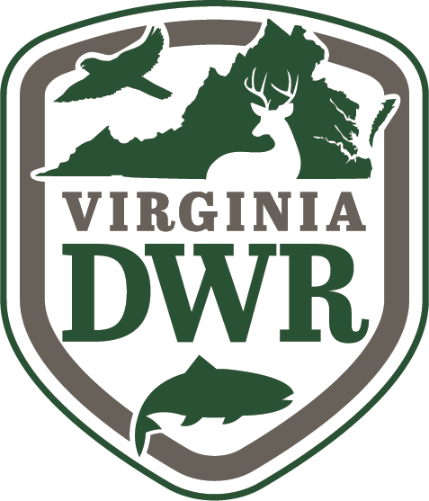
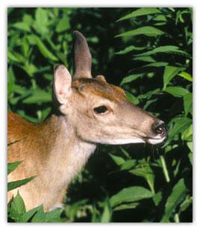
VA Department of Wildlife Resources
Mission:
Conserve and manage wildlife populations and habitat for the benefit of present and future generations.
Connect people to Virginia’s outdoors through boating, education, fishing, hunting, trapping, wildlife viewing, and other wildlife-related activities.
Protect people and property by promoting safe outdoor experiences and managing human-wildlife conflicts.
http://www.dwr.virginia.gov

Slide 18
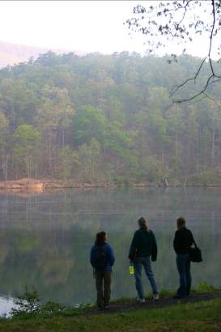
VA Department of Conservation and Recreation
Mission: DCR enables and encourages people to enjoy and benefit from Virginia’s natural and cultural resources
State Parks
Soil and Water Conservation
Natural Heritage Program
Dam safety and floodplain management
Land conservation
Recreation planning
http://www.dcr.virginia.gov

Slide 19
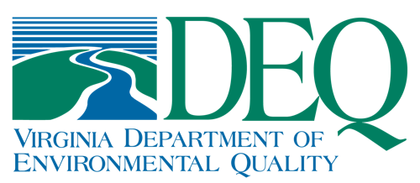
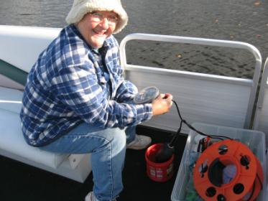
Virginia Department of Environmental Quality
Mission: DEQ protects and enhances Virginia’s environment, and promotes the health and well being of the citizens of the Commonwealth
Administers state and federal laws and regulations for air quality, water quality, water supply and waste management.
DEQ issues permits, conducts inspections and monitoring, and enforces regulations and permits
Organizes citizen water quality monitoring

Slide 20
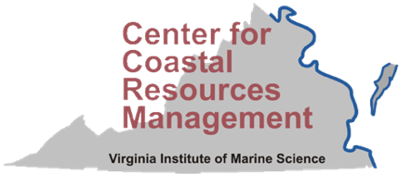
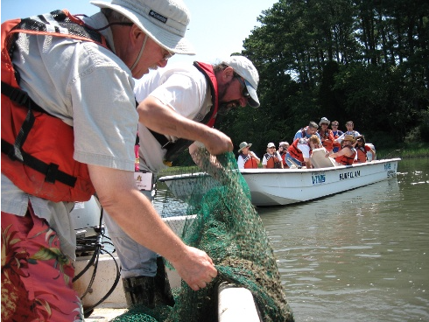
Virginia Institute of Marine Sciences: Center for Coastal Resources Management
Mission: CCRM supports informed decision-making on resource management at all levels of government, including private and corporate citizens.
Undertakes research
Provides advisory service in wetlands management
Conducts outreach education
ccrm.vims.edu

Slide 21
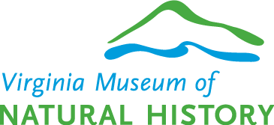
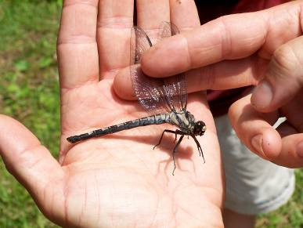
Virginia Museum of Natural History
Mission: VMNH interprets Virginia's natural heritage within a global context in ways that are relevant to all citizens of the Commonwealth.
Maintains a state museum to provide a repository of the state’s natural heritage
Investigates natural history of Virginia and the world
Conducts educational programs at the museum and across the state
http://www.vmnh.net

Slide 22
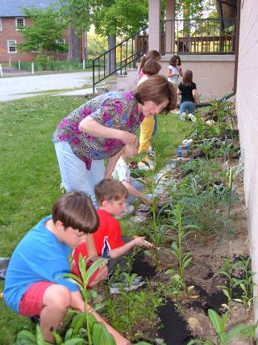
Virginia Cooperative Extension
Virginia Cooperative Extension helps lead the engagement mission of Virginia Tech and Virginia State University, the commonwealth’s land-grant universities. Building local relationships and collaborative partnerships, we help people put scientific knowledge to work through learning experiences that improve economic, environmental, and social well-being.
Program Areas:
agriculture and natural resources
4-H youth development
family and consumer sciences
community viability
http://www.ext.vt.edu

Slide 23
Program Structure
Local Partners
Providing training and volunteer opportunities
Chapter Advisor
Local representative of one of the 7 sponsoring agencies
Chapters Led by volunteer officers and committee chairs
Made up of certified Virginia Master Naturalists and individuals working towards certification
Executive Committee
Represents the sponsoring agencies and makes final decisions about policy, personnel, and budget.
Steering Committee
Develops program policies and advises program operations. Approves chapter activities.
State Office (Director, Program Assistant)
Leads program development, supports operations of program, provides a central source for program information
Notes:
The program is organized into semi-autonomous chapters that are led by volunteers. Each chapter has a chapter advisor who is a local representative of one of the 7 sponsoring agencies. Each chapter also works with local partners that help train the volunteers or provide them with volunteer opportunities. At the state level, the Steering Committee is made up of representatives of each of the sponsoring agencies as well as some volunteers. The Steering Committee develops program policies, advises program operations, and assists with statewide initiatives. The Executive Committee represents the sponsoring agencies and makes final decisions about program personnel and budget. As the program director, I liaison with all of these groups, lead program development, and provide a central source of program information.

Slide 24
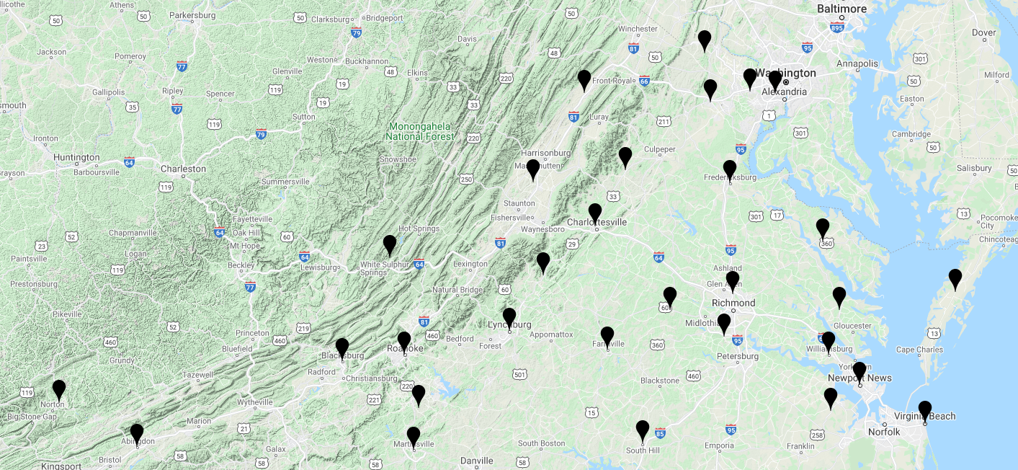
Virginia Master Naturalist Chapters
Notes:
Since the program launched in 2006, we have grown to 30 chapters around the state. Our newest chapter is the Southern Piedmont Chapter, in the southside area of Meckenburg County and neighboring counties. The chapters are in both rural and urban areas. Some focus on one county and others cover multiple counties.

Slide 25
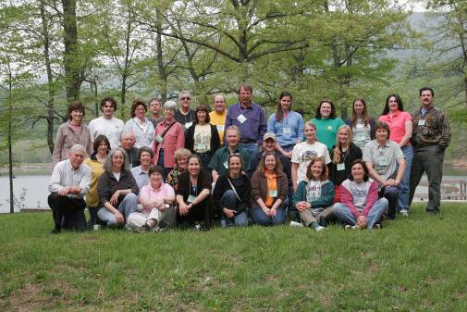
Program Structure
Master Naturalists are part of a local team, or “chapter” that is volunteer-run.
Participating in chapter governance, organization, and activities is an important part of being a Virginia Master Naturalist volunteer.
Master Naturalists are also part of a larger statewide structure. They must adhere to statewide policies and keep records of their service to report back to the state.
Volunteers and chapter advisors meet together at the 2006 New Chapter Coordinators’ Training
Notes:
Take-home points:
You’re part of a statewide program and are considered volunteers of Virginia Cooperative Extension. As part of that role, there are certain expectations such as volunteer screening, documenting your activities, and following program policies and codes of conduct. You are also part of a local chapter, and your contributions to help keep the local chapter running are important.

Slide 26
Certification Process
Basic Training 40 hours Classroom and field experiences Natural history, conservation and management, teaching and research skills Led by local experts
+
Continuing Education 8 hours Specialized topics that build on basic training Required annually to maintain certification
+
Volunteer Service 40 hours Education, citizen science, or stewardship Required annually to maintain certification
=
Certified Virginia Master Naturalist
Notes:
The process of becoming a Certified Virginia Master Naturalist begins with enrolling in and graduating from one of the basic training courses offered by our chapters. 8 additional hours of advanced training are required. The biggest focus for the program is the volunteer service (a minimum of 40 hours). Both the 8 hours of advanced training and the 40 hours of volunteer service must completed annually to maintain certification.

Slide 27
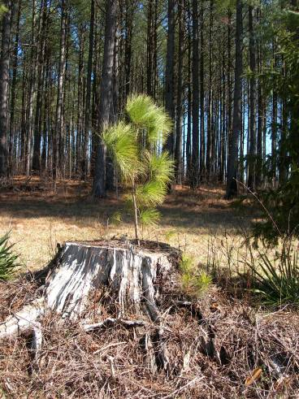
A Virginia Master Naturalist Knows…
Mission, objectives, and guidelines of the program
Significance of naturalists and natural history
Biogeography of Virginia
Ecology (basic concepts)
Geology (basic concepts)
Resource management (basic principles)
Some native flora and fauna in the region
Process of science
Roles of Virginia state agencies in the management and conservation of natural resources
Notes:
Each chapter sets its own schedule and syllabus for the basic training course. The course is tailored to the local environment, local instructors, and local natural resources. Wherever you are in the state, however, there are some core objectives that are the same across all chapters.

Slide 28
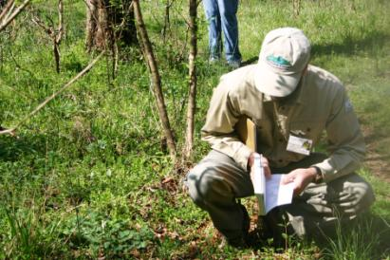
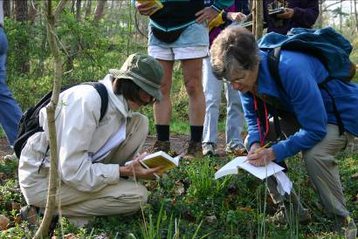
A Virginia Master Naturalist Can…
Use a key to identify organisms
Use a field guide
Share knowledge with others
Make and record observations in nature
Recognize when he or she does not know the answer to a question, but be able to seek out answers from people, books, or other reliable resources
Notes:
We also expect that, no matter the chapter, Master Naturalists will have these core skills that they can apply to their volunteer service.

Slide 29
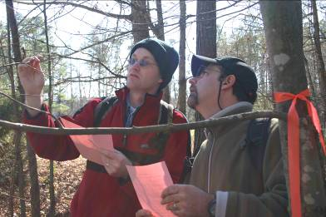
Continuing Education-Objectives
Promotes continued learning and development of naturalist skills
Provides knowledge and skills necessary to work in local volunteer efforts
Provides an opportunity to focus interests
Builds on the core curriculum initially provided
Provides information on natural resources and resource management applicable to VA
May be 8 hours of one training, or a series of shorter trainings
Notes:
The basic training course is very broad and doesn’t have time to go very deep. Advanced training is an opportunity for volunteers to dig deeper into the subject matter and develop specific skills needed for their service projects.

Slide 30
Continuing Education-Examples
Short courses and workshops offered by state or local partners on specialized topics such as forest management or public speaking skills
Training specific to a planned service project such as invasive plant ID or stream monitoring
Public lectures on natural history topics if they meet the continuing education objectives and pertain to local natural resources

Slide 31
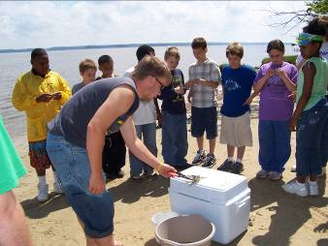
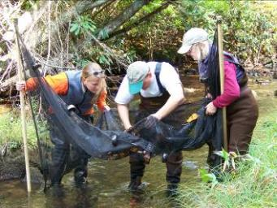
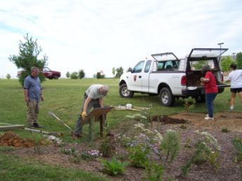
Education
Citizen Science
Stewardship
Notes:
Whether they prefer digging in the dirt, sharing the wonders of nature with youth, or collecting data to help monitor the health of our wildlife populations, Virginia Master Naturalists can find a volunteer project that fits their interests and skills. Virginia Master Naturalists volunteer for three types of projects: education, citizen science, and stewardship. Each chapter works with state and local partners to offer a mix of these project types.

Slide 32
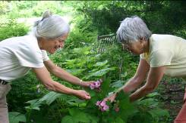
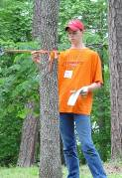
Volunteer Service Project Guidelines
Minimum of 40 hours to maintain certification
Must be dedicated to the beneficial management of the natural resources within the local community
Must be for public benefit, not personal gain
May be a series of short, unrelated experiences, a long-term commitment to single project, or a mix
Can be conducted independently or as a team
Can be part of an existing partner project, a new project developed by the volunteer, or a class project
Notes:
Your volunteer work must be done on an approved project. You can propose a new project for approval as well, but you need to do this before starting the volunteer work on it. [HANDOUT PROJECT PROPOSAL FORM IF DESIRED]. Here are the basic guidelines for volunteer service projects.

Slide 33
Volunteer Service: Administrative
For volunteers spending time on chapter organization!
Examples:
planning and supervising VMN training classes,
serving as a board or committee member,
working on a chapter newsletter,
communication efforts,
other activities that support the effectiveness of the chapter and statewide program
Note: Local Chapters, at their discretion, may limit the number of such hours credited to an individual’s annual volunteer requirement.

Slide 34
Volunteer Service: Education
For volunteers who enjoy public speaking or working with youth!
Examples:
Being a volunteer interpreter at a state or local park
Developing an interpretive trail
Being a guest presenter on a natural resource topic in a classroom

Slide 35
Volunteer Service: Citizen Science
For volunteers who enjoy helping with scientific research!
Examples:
Participating in a Christmas Bird Count
Conducting water quality monitoring
Organizing biodiversity inventory of a local park

Slide 36
Volunteer Service: Stewardship
For volunteers who just want to get their hands dirty!
Examples:
Maintaining trails at a state park
Pulling out exotic invasive plants and planting natives at a nature center
Restoring bird-friendly habitat at a local park

Slide 37
Young Naturalist 4-H Camp at Bear Creek Lake State Park
Habitat Education at the Williamsburg Farmers Market
Notes:
Since 2013, the Central Piedmont Chapter of the VMN program has collaborated with Cumberland County 4-H and Bear Creek Lake State Park staff to develop a Young Naturalist Day Camp for 9 to 13 year olds. Youth enrolled in the camps receive exposure and instruction relating to mammals, reptiles and amphibians, insects, owls and other birds, fishing and canoeing, dip-netting for critters, tracking, and keeping a naturalist field journal.
Historic Rivers Master Naturalists put together an educational booth for their local farmers market where they shared information about landscaping for wildlife. This project involved putting together the display materials as well as talking with the public at the event.

Slide 38
Bat monitoring at Pocahontas State Park
Stream monitoring in the New River Valley
Notes:
Fifteen volunteers devoted 215 Citizen Science service hours to bat monitoring at Pocahontas State Park. This project was carefully designed from the start, and the projected monitoring sites and volunteers hours were right on track when the data was tabulated for the first bat monitoring season in 2014. Each week from April to October, volunteers gathered for quick instructions on how to count bats at selected sites, then set off in pairs to survey the eight to ten sites identified as most active. The teams worked to hone their observation skills in this challenging environment, determined criteria that would help them arrive at more accurate counts by careful monitoring of flight behaviors and feeding patterns, and worked as a team to collect data. In addition, after surveying existing bat houses and researching the most successful designs for new houses, volunteers built and installed four rocket-box-style bat houses in 2014. They spent the winter months constructing additional houses and maintaining existing houses.
The NRV Chapter applied for and received a $4,000 grant from the VA Department of Environmental Quality for a Citizen Water Quality Monitoring Program. The area covered by the NRV Chapter lies on the Eastern Continental Divide and encompasses the headwaters of three watersheds. At the time, there were no water-quality monitoring programs for collecting data in these watersheds. The initial stream sampling plan included a total of nine locations in the New River and Roanoke River watersheds. These locations were sampled for physical and chemical parameters from August through December in 2014, and for bacteria from September through December. In addition, five locations were sampled for benthic invertebrates in the fall of 2014. Money from the grant allowed the chapter to purchase a pH/DO/temperature meter as well as pay for E. coli analyses for the September through December sampling events. Another goal of the Citizen Water Quality Monitoring Program was to train additional volunteers to be Certified Save Our Streams monitors. Training classes were held in October through November and resulted in the certification of five additional SOS volunteers. This project involved nine volunteers totaling 100 service hours.

Slide 39
Notes:
A group of volunteers from the Banshee Reeks Master Naturalist chapter in Loudoun County formed a “Weed Battalion” to manage invasive plants at the Banshee Reeks Nature Preserve. They mapped the locations of the invasives, conduct regular work days to remove the invasives and restore the habitat, and created an educational brochure about the invasive plants at the preserve. They have contributed thousands of hours of labor to this project and earned the “Outstanding Volunteer Project” award from the Loudoun County Board of Supervisors.

Slide 40
I have always enjoyed working together with my mom on VMN projects. Sharing experiences, going to new places, and learning new things together always makes me happy. Also, if we’re out doing a project or program, and one of us forgets a fact or location, the other usually remembers.
(Elena Swick, Central Rappahannock Chapter)
Notes:
I’m going to end by sharing with you some reflections from our Virginia Master Naturalists themselves, which I think give you more of a sense for the program impacts than I can offer. Take Melanie and Elena Swick, for example, a mother-daughter team who have been participants in the program since its beginnings. Nature was really Elena’s passion, but mom Melanie signed up for the program too because Elena wasn’t old enough to participate on her own. Since then, they have become an amazing team! They have given eagle tours at Caledon Natural Area, monitored bluebird boxes at local parks, given
educational presentations for Extension, participated in bird and frog counts, coached and competed on WHEP & Envirothon teams, gotten wet on World Water Quality monitoring day, collected seeds for Growing Native, reported data for the DGIF Wildlife Mapping
project, taught 4th graders about macroinvertebrates, maintained trails, and cleaned beaches at Caledon. Later, her experience as a Master Naturalist got Elena the job of her dreams as an interpreter at Caledon State Park.

Slide 41
I can't tell you how much I have enjoyed the Master Naturalist program. It has opened new interests, provided education, and new friendships. It truly has changed the way I look at the world. The VMN program continues to be one of the highlights of my life.
(Temple Moore, Northern Neck Chapter)
Notes:
More than one Virginia Master Naturalist has told me that the program has changed his or her life. One person told me it even improved his marriage, giving him and his wife fun outdoor activities they could do together!

Slide 42
The Virginia Master Naturalist program transforms lives: our own, and those of the people and other beings that we serve under VMN.
(Kim Scudera, Fairfax Chapter)

Slide 43
The Master Naturalist class was my first retirement project, a home run of a choice. I learned so much. The first project my husband and I did -- a trail guide for Menokin -- pulled information from every class topic. It was a great final exam for me, the writer on the project. And my husband, who did 14 original watercolors to illustrate the trail guide (and also designed the brochure), said he enjoyed painting for a purpose, instead of just for a class or for himself.
(Jann Steele, Northern Neck Chapter)
Notes:
Sometimes the program can help people channel their existing skills and interests into activities that benefit their community and environment.

Slide 44
I thoroughly enjoyed my time with the Master Naturalist class on Tuesday.
They are a sharp, curious, and attentive group; and I could only wish my
undergraduate students had their zest for learning!
(Scott Eaton, guest instructor for Old Rag Chapter)
Notes:
Guest instructors who teach the basic training course classes find the volunteers to be very engaged students!

Slide 45
I am learning so much from this class , one of the best things I have ever done ! And it is only starting…
(John Holden, Rivanna Chapter)

Slide 46
I was given the opportunity to be a seasonal educator for the Cradle of Forestry Interpretive Association…Had I not taken this path of the Master Naturalist, I never would have had the confidence to do it.
(Bunny Medeiros, Holston Rivers Chapter)
Notes:
One volunteer in southwest Virginia found that the program gave her the confidence to teach others about nature.

Slide 47
I want to say a big “THANK YOU” to you and all of the Old Rag, Rivanna and Shenandoah Master Naturalists who came out to Montpelier and labored over two days to pull so much garlic mustard out. Your group was certainly a breath of fresh air . . . I love it that all of you actually enjoy doing this!
(Sandra Mudrinich, horticulturist at Montpelier)
Notes:
They can be very dedicated volunteers, and a real asset for local partners.

Slide 48
Stay in touch with the Virginia Master Naturalist Program!
www.VirginiaMasterNaturalist.org
www.facebook.com/VirginiaMasterNaturalist
twitter.com/VA_Naturalists
Notes:
You can now go to www.virginiamasternaturalist.org and click “Stay connected” to sign up to receive communications from the statewide office such as our newsletter, notices of continuing education webinars, etc. You can also stay connected via Social media with Facebook and Twitter.

Slide 49
Virginia Master Naturalist Program masternaturalist@vt.edu
434-872-4587
www.VirginiaMasterNaturalist.org

Slide 50
Standards of Conduct
Virginia Master Naturalist volunteers shall at all times:
Act in accordance with the VMN Volunteer Policy Handbook and the applicable policies of the chapter, sponsoring agencies, and partners with which they serve.
Present a positive public image that speaks well of the Virginia Master Naturalist program and its sponsoring agencies.
Be respectful and courteous of others in all communications and interactions.
Maintain and report accurate records relating to their training and service.
Accept supervision and support from VMN sponsoring agency employees while involved in the program.
Comply with the nondiscrimination policies of the VMN program and its sponsoring agencies, and make all reasonable efforts to reach underrepresented audiences with VMN programs.
Actively participate as a positive team member with other individuals in the VMN program.

Slide 51
Scenario 1:
Tasha is in the current basic training course of the Old Rag Chapter of the VMN program. She really wants to achieve Certified Virginia Master Naturalist status. What does she need to do and by when?

Slide 52
Scenario 2:
Juan, a VMN volunteer, has some ideas for new service activities he wants to propose for approval by his chapter. Do these seem to fit the VMN guidelines for volunteer service?
Organize a community rally to protest the building of a parking garage next to a local park
Teach a class on tree identification for neighborhood residents
Picking up a few pieces of litter during a recreational hike
Serve as the treasurer for the local Audubon Society chapter
Lead a stream cleanup for ‘Save the Bay Day’
Collect stream health data with the James River Association

Slide 53
Scenario 3:
As part of VMN service, Chris is conducting an educational program on native plants for the public at a city park. What kinds of records does Chris need to keep relating to this volunteer activity?

Slide 54
Scenario 4:
While walking in the woods, VMN volunteer Casey finds an old shell of a box turtle. Casey collects the shell to use with the VMN chapter’s display at the Earth Day festival. Is this OK?

